Slide 1
Pop-Up Presenters
AIHA Connect 2026 NEW ORLEANS, la
Managing your online speaker account, action items, due dates, and what to expect onsite
Presented by Diana Kane, Manager, Education,
February 10, 2026

Slide 2
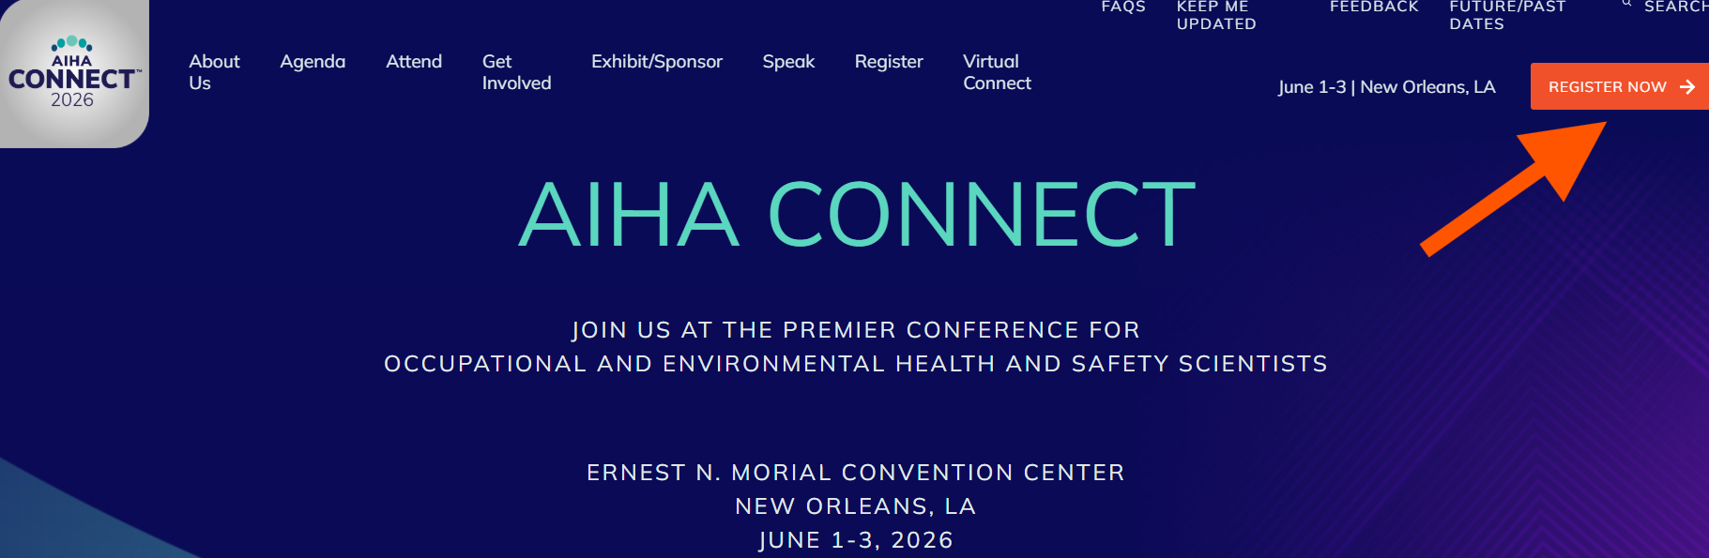
Registration is now open
All Pop-Up speakers must register for the conference
https://aihaconnect.org/register

Slide 3
AIHA Connect 2026 Format
AIHA Connect 2026 is an in-person event.
All Pop-Up Presenters are expected to attend and deliver their sessions in person at the conference.
Pop-Up sessions will not be broadcast virtually.
They will not be recorded for OnDemand.
All Pop-Up Sessions are
In the Expo Hall
Monday, Tuesday, Wednesday, June 1-3, 2026

Slide 4
Have You Signed Your Speaker Forms?
Details in your acceptance email
Each Presenter, Co-Presenter must complete
- Speaker Agreement *
- Session Delivery Form * One for each session in which you are involved
Check your Ready Room today to be sure all your forms and your profile are complete!
To access your speaker account, use the link: https://ww6.aievolution.com/aih2601/
Use your AIHA account username and password

Slide 5
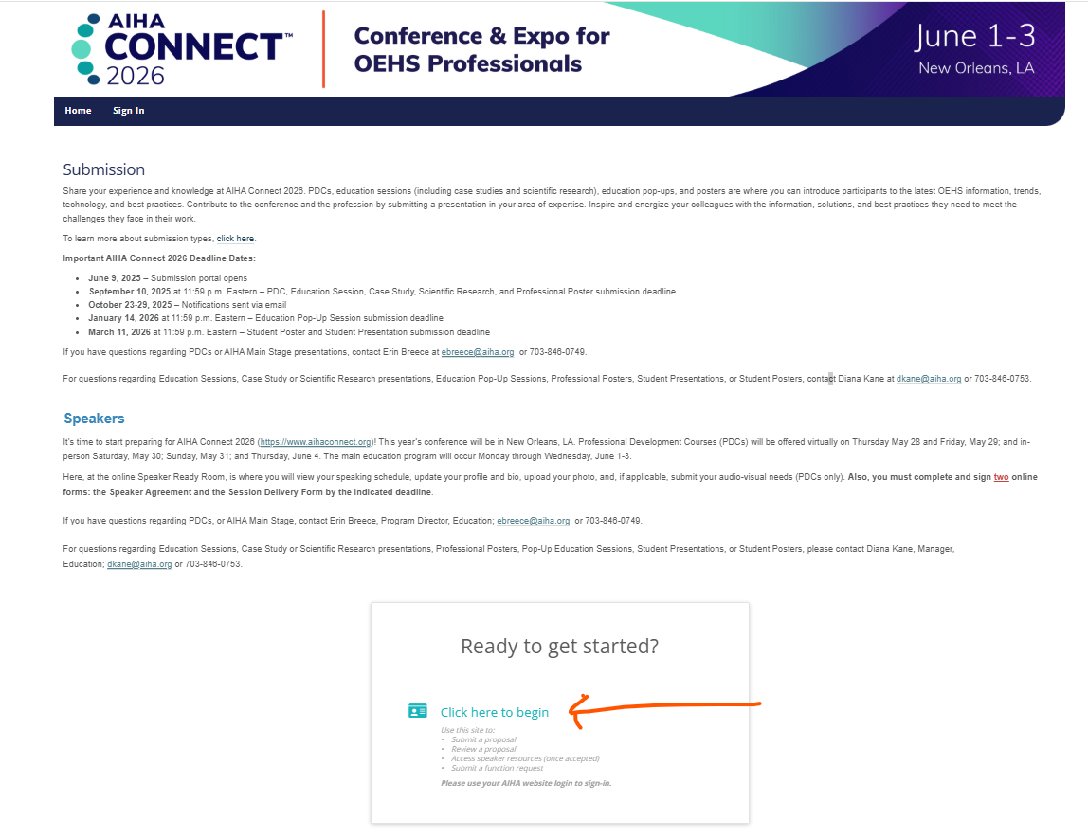
Notes:
Diana- review after demo
When you click on Log In, you will see this. Click here to begin will lead you to where you can complete your speaker agreement, session delivery form

Slide 6
Sign your speaker agreement
Step 1 - sign the Speaker Agreement
ALL speakers need to complete the Speaker Agreement
Review AIHA guidelines and convention center rules, and consent to adhere by signing the agreement.
Review the content, and digitally sign and date
DEADLINE: February 13, 2026
Notes:
Comply with all participation requirements; register for in-person conference; pay all registration fees – All presenters and moderators are required to register for the conference and pay the applicable full conference or one-day registration fee.
No discounted registration for speakers
Agree to designated day/time; present what was submitted and approved by the CPC
Inform Manager, Education (Diana) immediately if cannot present; look for possible replacement speaker
Aware of speaker webinar series – can view live or recorded

Slide 7
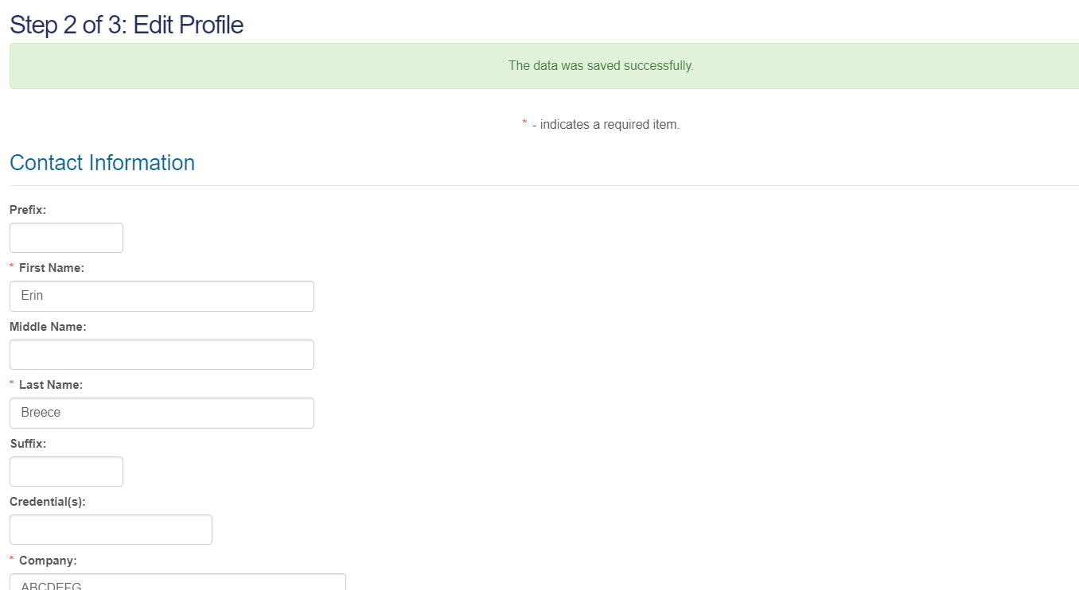
Edit your profile
Notes:
**Check that the email we have on file for you, is one you use often & is the one you will use when you register for the conference
** You can update your profile anytime.

Slide 8
Check Details of Your Profile
You will be receiving a personalized digital graphic just for you to use to promote your session; therefore, be sure the details of your profile are correct:
Is your name spelled correctly and followed by proper credentials?
Is your email correct? Be sure this is the one you used when you submitted your proposal and the one you use when you register for the conference
Is the name and address of your place of employment correct?

Slide 9
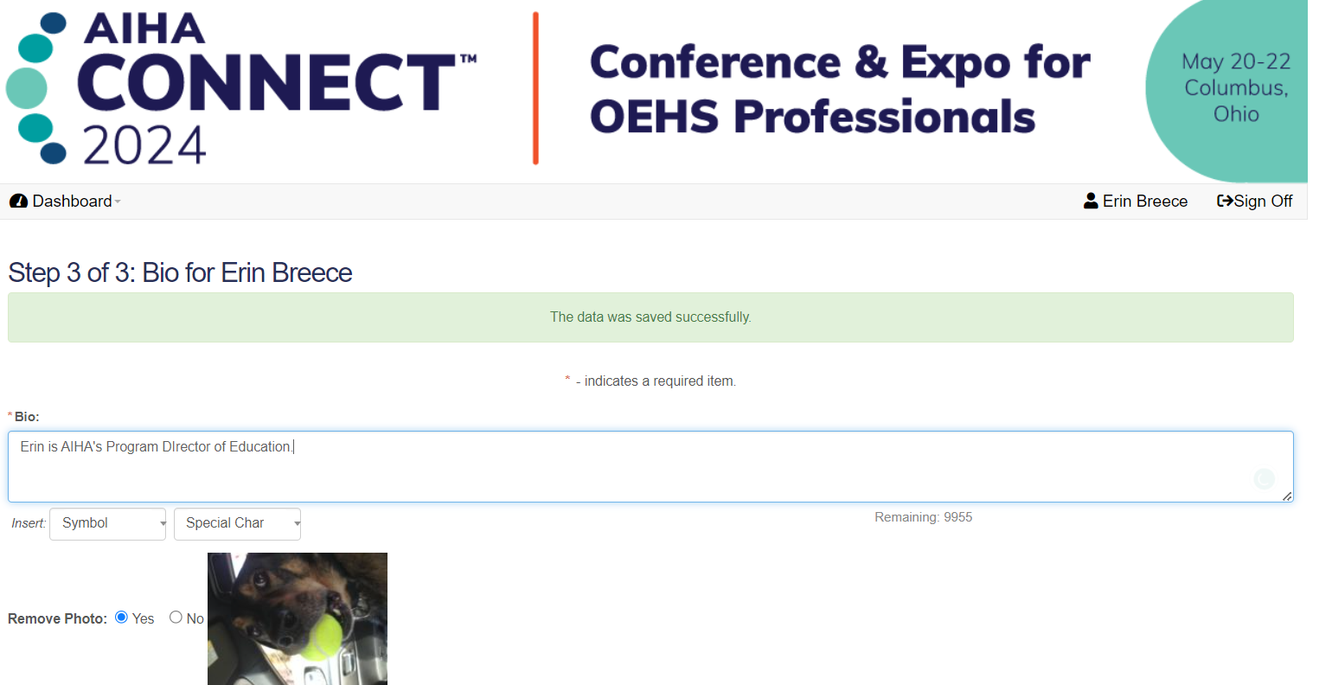
Review your bio & Add a Photo
The biography entered for you at the time of submission will auto-generate
Make changes, if needed, at any time
Upload a headshot style photo of yourself (optional)
For best results, use the noted sizing of 185 X 185 pixels

Slide 10

Attendee/public-facing view
Each session has a dedicated webpage
Information including name, credentials, company/org., city, state and country are displayed
Headshot is shown
Biography is visible, after clicking speaker name
Notes:
This is what the attendee sees

Slide 11
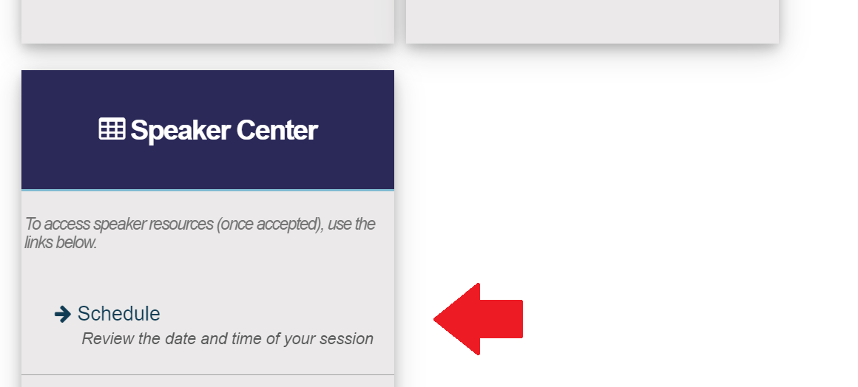
Clicking on Schedule under Speaker Center will take you to
My Ready Room where you will see details on Action Items and Deadlines.
Scrolling down, you will see your session details.
Notes:
After you have completed your forms, when you log in again you will see your Dashboard – grey & blue squares. Going to Speaker Center is where you will access the details of your presentation, including your Session Delivery, Broadcasting & Materials Form

Slide 12
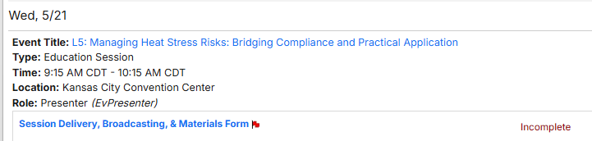
Session delivery, broadcasting & materials form
You will need to complete one for EACH session in which you are speaking
You to agree to AIHA’s Copyright Guidance Document and to the Artificial Intelligence (AI) Responsible Usage Policy

Slide 13
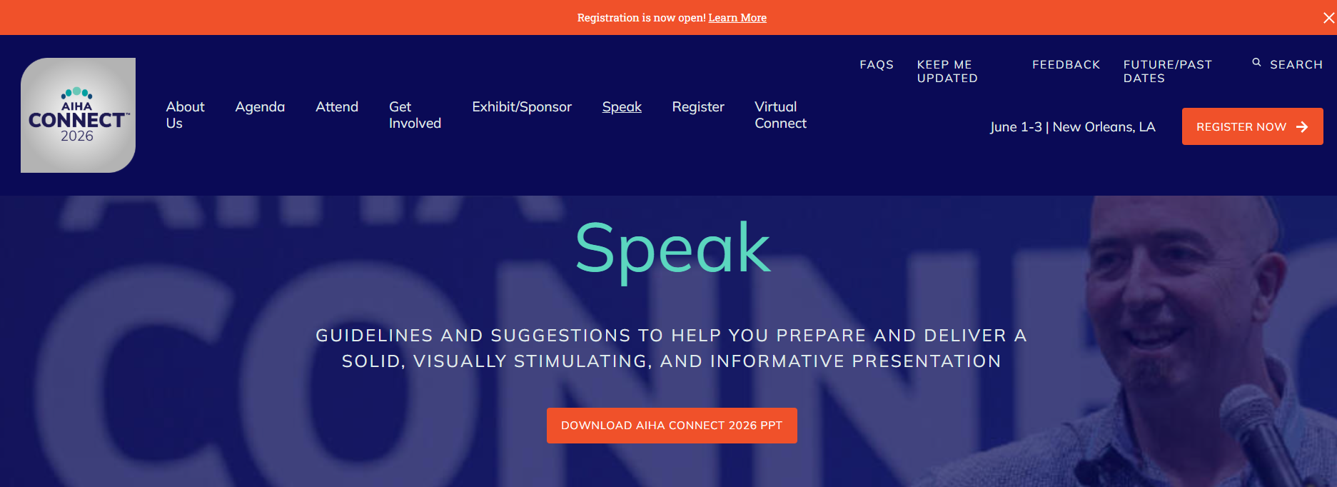
Conference PowerPoint Template

Slide 14
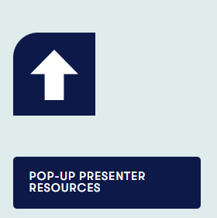
AIHA Connect Power Point
Download the 2026 PowerPoint Template
Our PowerPoint template is set to 16:9 ratio (widescreen)
If you choose to use your own template, please ensure that it is set to this format:
To check the ratio of your slides in PowerPoint:
1. Go to Design > Slide Size > Custom Slide Size.
2. Choose a slide size with the aspect ratio you want and select OK

Slide 15
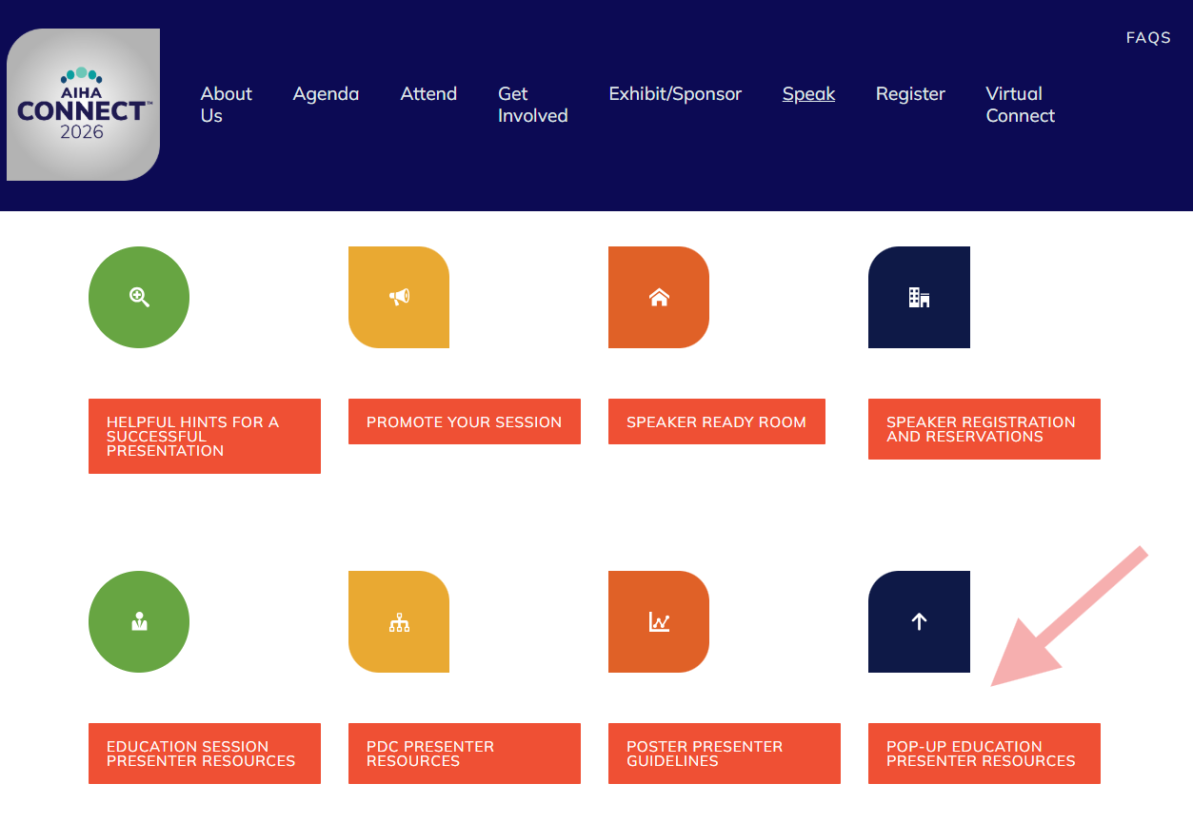
Accessing the Speaker Toolkit
Notes:
Toolkit has Resources for you

Slide 16
Pop-Up Presenter Resources
Dates to remember
On-site Requirements
Slide Preparation
Pop-Up Set up and Equipment

Slide 17
Speaker Ready Room
You are encouraged to visit the Speaker Ready Room at least one hour prior to the start time of their session.
The room is equipped with computers and AV technicians who can assist with editing and uploading presentations.
You can tweak your presentation, practice speaking, and ensure the latest version of your presentation is loaded to the Presentation Management System (available in March/April).
Hours (Central Time)
Friday, May 29: 5:15 p.m.–7:00 p.m.
Saturday, May 30: 7:00 a.m.–5:30 p.m.
Sunday, May 31: 7:00 a.m.–5:30 p.m.
Monday, June 1: 8:00 a.m.–4:00 p.m.
Tuesday, June 2: 7:00 a.m.–5:15 p.m.
Wednesday, June 3: 7:00 a.m.–3:00 p.m.
Thursday, June 4: 7:00 a.m.–5:00 p.m.

Slide 18
Timing for Pop-Up Sessions
Arrive at the speaking location at least 15 minutes prior to your start time
Pop-up Presentations are 25 minutes in length
Use your full time and end on time
Make note of the volunteer who is monitoring timing. This volunteer will be showing you timing cards to assist you with staying within your allotted time
The AV staff will assist you with your mic

Slide 19
Room Set & Equipment
This year Education Pop-Ups will be in the Expo Hall
You will have a microphone, and there will be a laptop, slide advancer, and display monitor for you to present your slides.
There will be an AV tech there to assist you in getting ready
We will be using our Presentation Management System
(more details coming by end of February)
You will upload your presentation ahead of time, then it will be beamed to computer at Pop-Up location

Slide 20
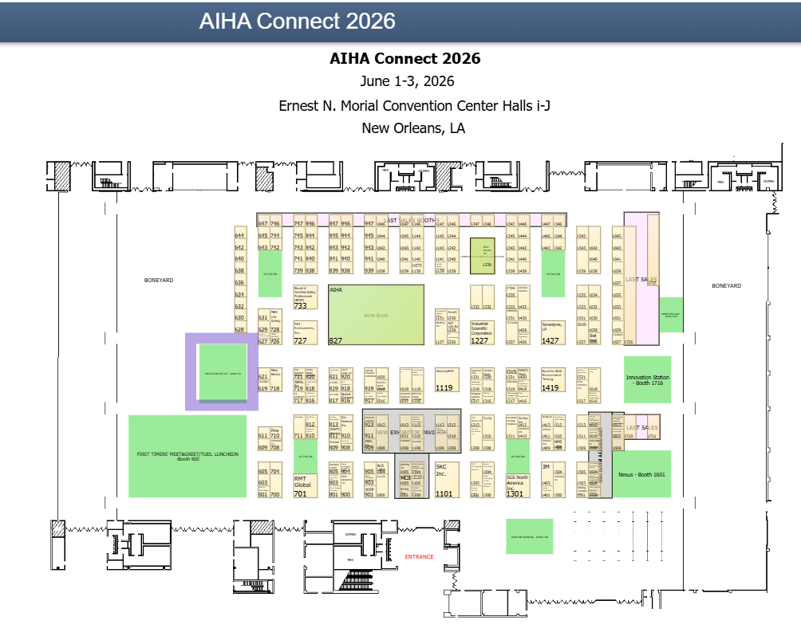
Notes:
Diana – Expo Hall

Slide 21
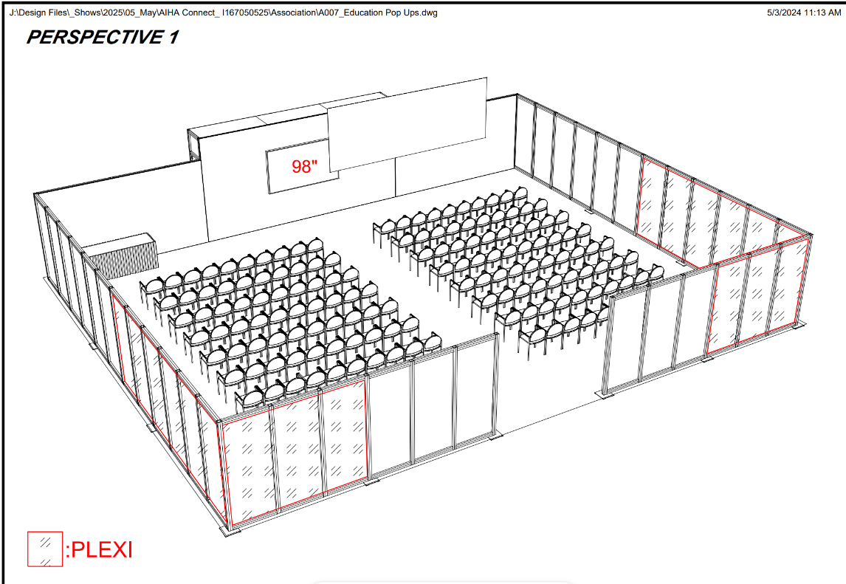

Slide 22
New Orleans Ernest N. Morial Convention Center Rules & Regulations
Convention center staff are responsible for the setup, change, and breakdown of all activities.
Room sets and capacities are approved in advance by the facility and the New Orleans Fire Marshal. Room sets, must remain as indicated on approved floor plans. Speakers and moderators agree they will not move any items pre-set by the facility or AIHA.
Audiovisual equipment must be provided by AIHA’s exclusive provider. Requests for AV other than what is outlined to presenters in advance by AIHA must be paid for by the speaker before equipment will be provided. Speakers may not provide audiovisual equipment of any kind in their session rooms, including handheld polling devices.
Speakers may hand-carry handouts or other materials for distribution during a session (except any type of AV). No carts or dollies are permitted. If you require a cart, dolly, luggage carrier, or hand truck to carry your materials, please contact AIHA.
Due to use of the rooms for other AIHA Connect events, you may not access the room more than one hour before your session or leave items overnight.
If you think you will need accommodations to any of the above-listed items – for any part of your session – please let AIHA staff know immediately. We are happy to work with you on a solution that will ensure the success of your session AND compliance with our contract with the conference center.
Note: requests received after April 1 will not be accommodated.
Notes:
Diana
we must follow all rules and regulations of the Convention Center for hosting a meeting in the facility. Please help us by noting:
The conv ctr staff are responsible for all setup, change over, and breakdown of all rooms based on the room layouts approved by the facility and the fire marshal.
Any alterations of the approved room sets may result in violations and associated fees, so we ask that you refrain from moving room sets during the program.
AV is provided by our exclusive AV provider; the standard equipment is being provided for all sessions. Addl AV needs will be invoiced to and must be paid for by the requesting speaker before the equipment will be provided.
If you will need accommodations to any of these items, please talk reach out to us about your needs before April 1. We will do our best to accommodate while ensuring we also comply with our contractual obligations.

Slide 23
Pop-Up presenter Dates to Remember
February 13 – sign Speaker Agreement, complete Session Delivery Form, review Profile Information, update your Biography, and upload your Photo
March 6 – Review all content on the Speaker Toolkit section of the AIHA Connect website
March 29 – Register for AIHA Connect to get the Advance Rate
May 1 – Upload optional handout materials for attendees
June 1-3 – Pop-Up session presentation dates
Notes:
Diana

Slide 24
Webinar Schedule 2026
NOTE: dates are subject to change
VISIT WWW.AIHACONNECT.ORG, CLICK “SPEAK,” THEN “HELPFUL HINTS FOR A SUCCESSFUL PRESENTATION”
v
Webinar Day | Time CDT | Topic
Tuesday 2/24/2026 | 2:00 PM | Presenting at AIHA Connect- uploading PPT, review of resources online, timeline, deliverables, copyright information; Presentation Management System
Tuesday 3/24/2026 | 2:00 PM | Promoting Your AIHA Connect session - spreading the word through social media
Notes:
Diana ---
Found at the Helpful Hints icon

Slide 25
Next webinar
Mark your calendars for your next Speaker Webinar:
Join the webinar at www.aihaconnect.org, click on Speak, then Helpful Hints for a Successful Presentation
Presenting at AIHA Connect
Uploading PPT, review of resources online, deliverables, copyright information,
Presentation Management System
Tuesday, February 24 at 2 p.m. ET

Slide 26

Questions?
Education Sessions, Research Round Ups, Pop-Up Education, Posters
Diana Kane, 703-846-0753, dkane@aiha.org

