Slide 1
AIHA NATIONAL
An Introduction: What Makes AIHA Critical to Business
Revised October 2025

Slide 2
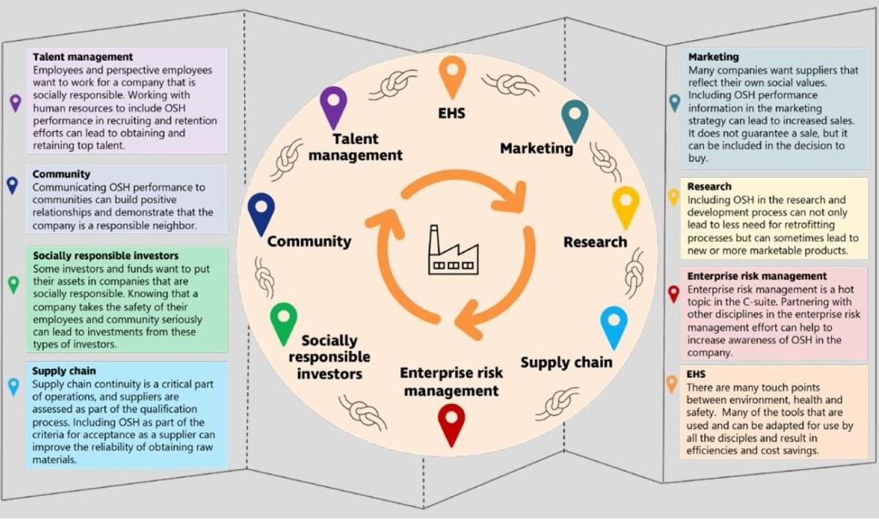
How Does Our Profession Support Good Business?
Source: Wolfsberger, J. and G. G. Zigulis (2023). "INTEGRATING OSH INTO THE BUSINESS STRATEGY." Professional Safety.

Slide 3
Intro to aiha

Slide 4
About AIHA
AIHA is the association for scientists and professionals committed to preserving and ensuring occupational and environmental health and safety (OEHS) in the workplace and community.
Founded in 1939, we support our members with our expertise, networks, comprehensive education programs, and other products and services that help them maintain the highest professional and competency standards.
More than half of AIHA's nearly 8,500 members are Certified Industrial Hygienists, and many hold other professional designations.
AIHA serves as a resource for those employed across the public and private sectors, as well as for the communities in which they work.
aiha.org/about-aiha

Slide 5







AIHA Organization Structure
AIHA Consolidated
501(c)6
LLCs
501(c)3

Slide 6
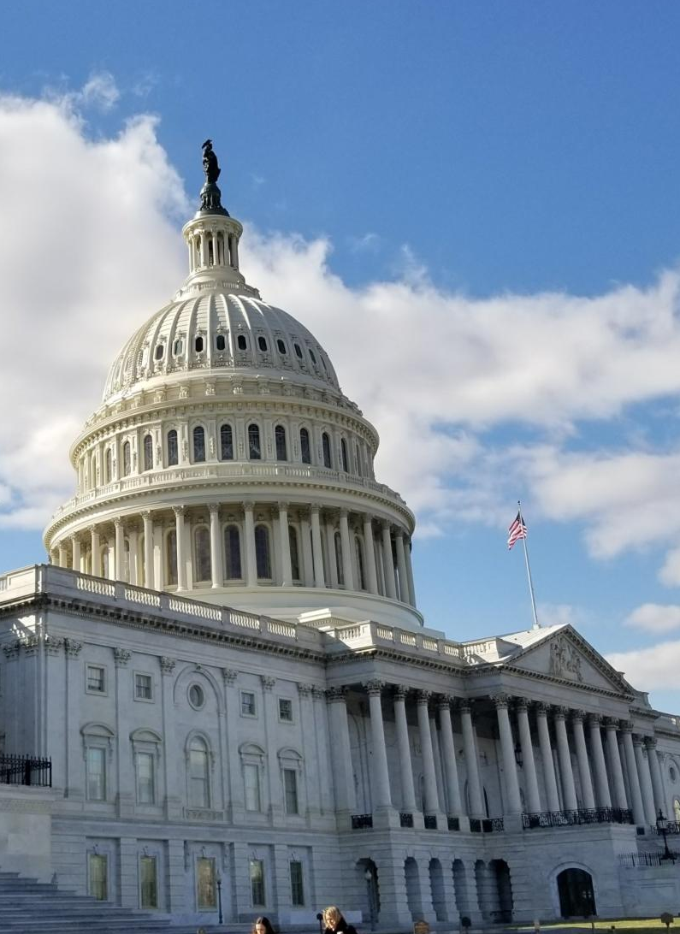
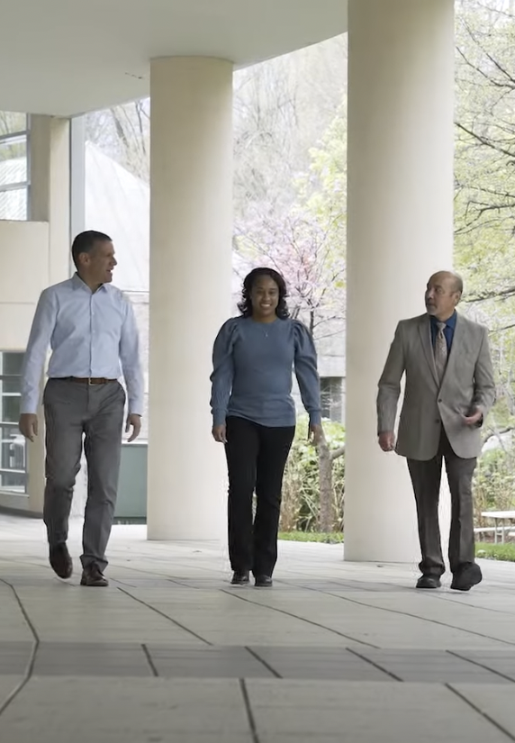

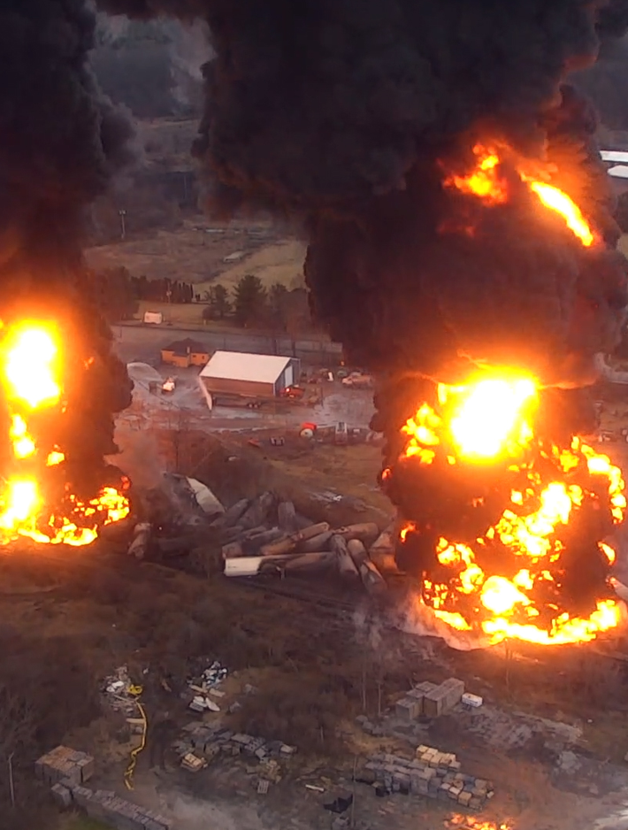

AIHA Supports OEHS Professionals
Occupational & Community Exposure Limits
Advocacy
Public Awareness
Lab Accreditation & Proficiency Testing

Slide 7


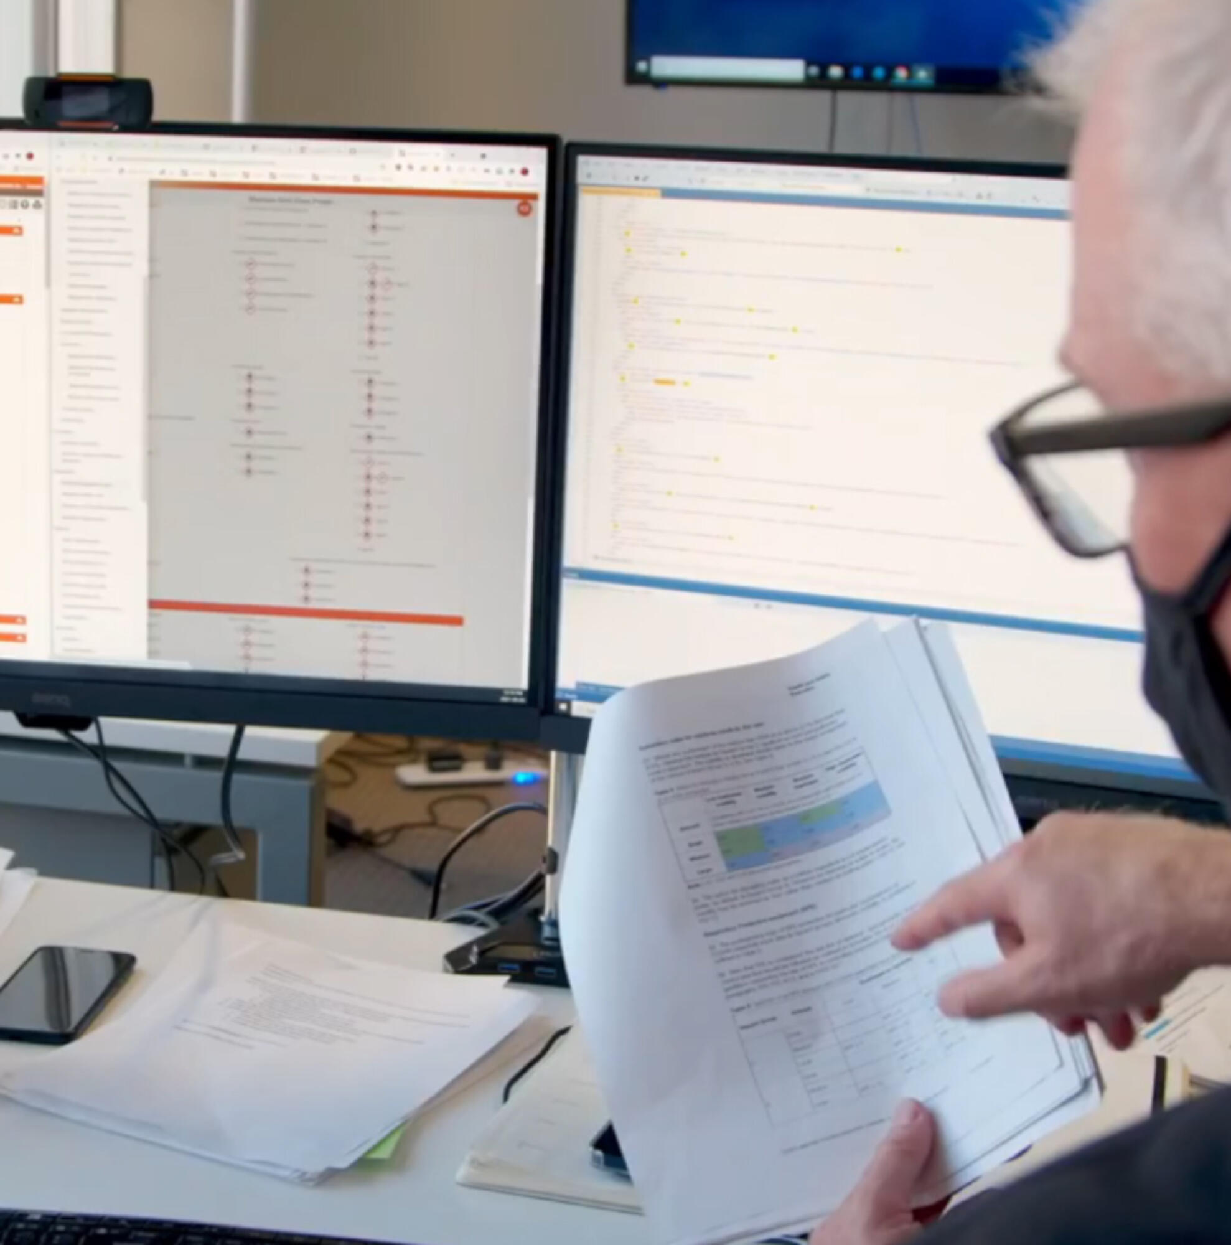
AIHA Supports OEHS Professionals
OEHS
Education
Exposure Risk Decision Resources
Career Development

Slide 8



AIHA Supports OEHS Professionals
Future Guidance
OEHS Professional
Credentialing
Global Outreach

Slide 9
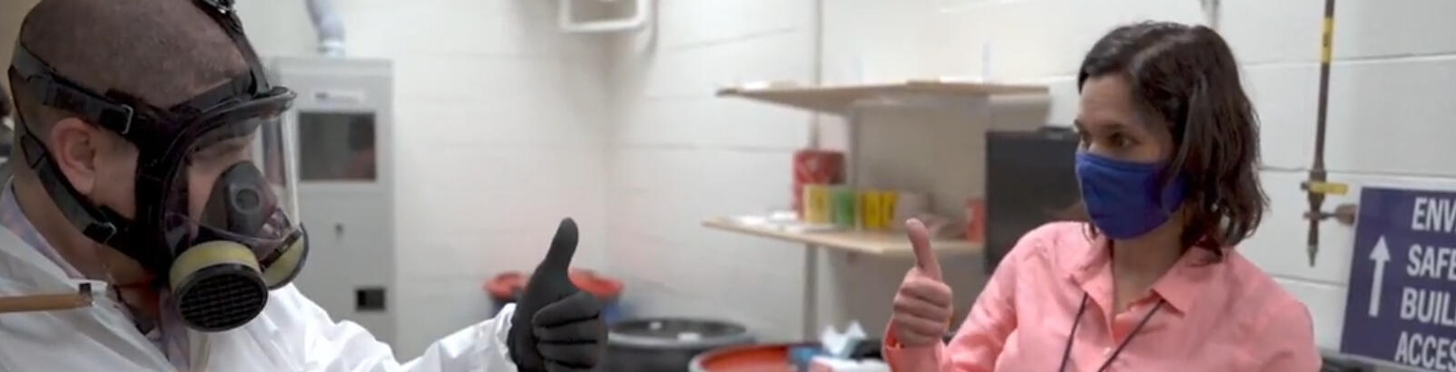
AIHA Strategic plan: 2025-2027
Our Core Values
Prevent | Empower | Advocate | Collaborate | Respect
Strategic Domains
Pursuit of Knowledge
Advancing the Profession
Member & Volunteer Engagement
Impact & Awareness

Slide 10
Safety for nonprofits

Slide 11

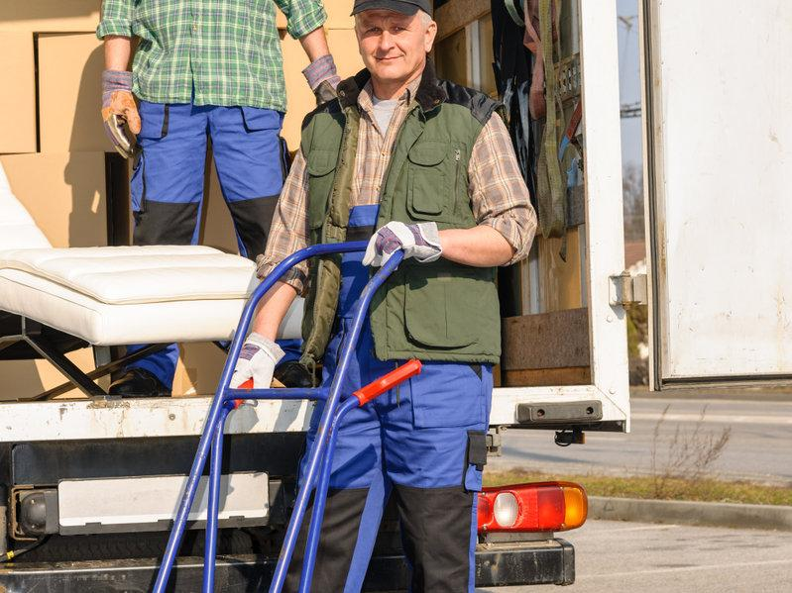
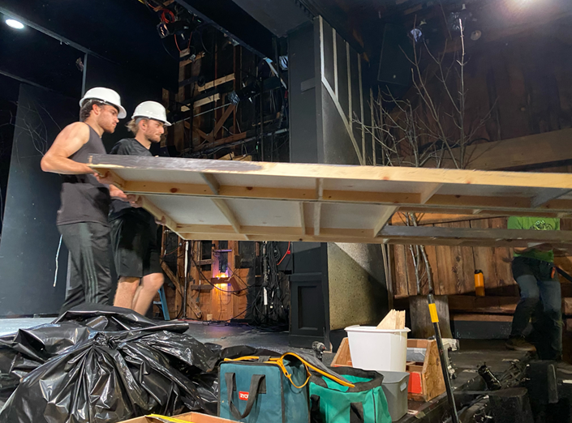
S4NP - Safety For Nonprofits
Worker safety and health at many nonprofits is not recognized as an area needing attention
NIOSH and BLS studies found that every week, on average, a volunteer worker dies on the job
Founded in 2019, S4NP volunteers are safety & health professionals that partner with nonprofit organizations to assess potential hazards and safety risks in their workplaces and provide recommendations to minimize or eliminate them

Slide 12
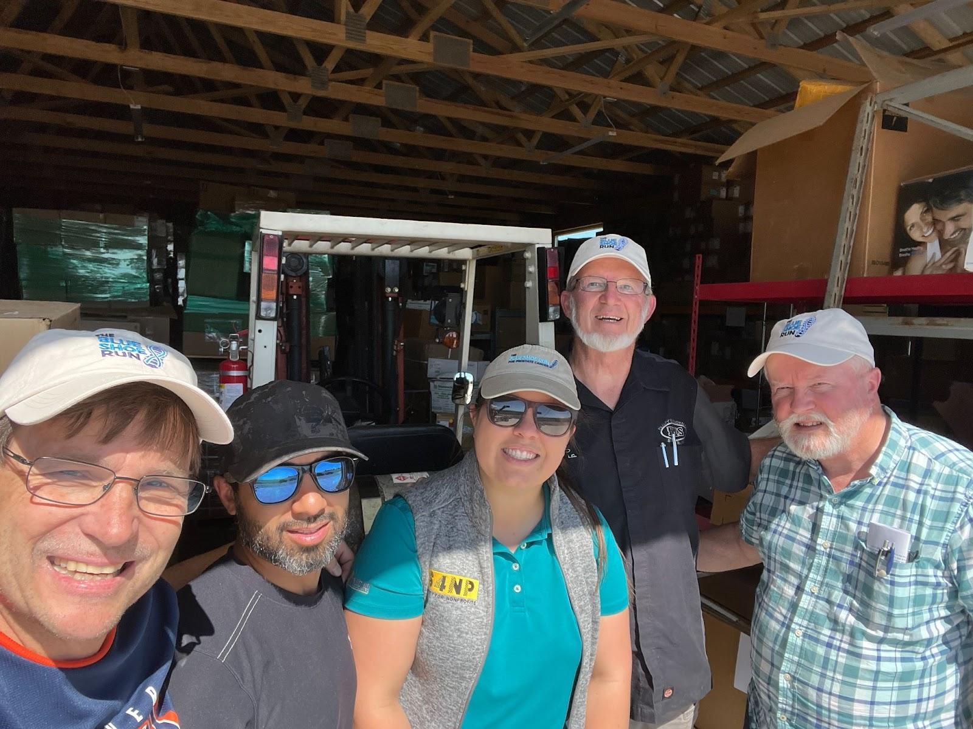
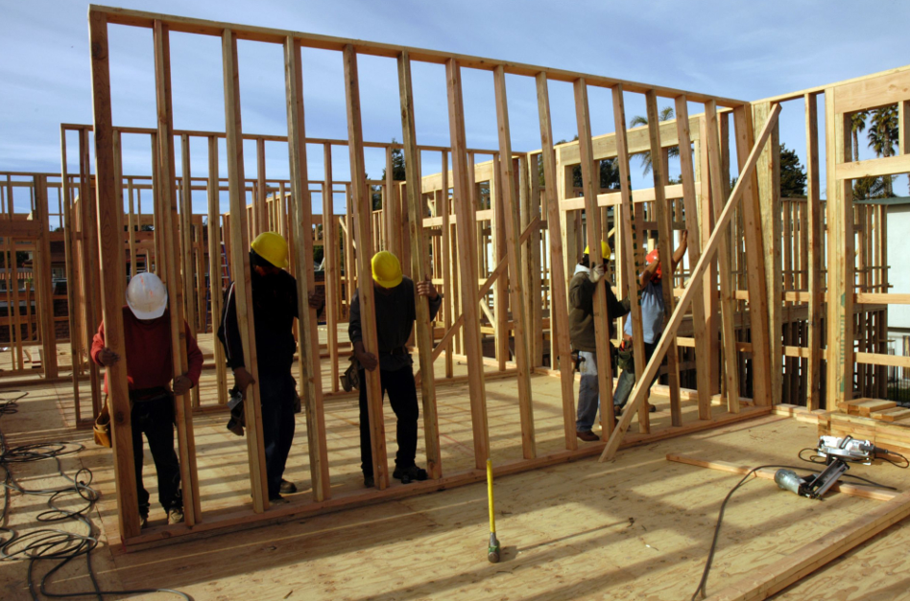
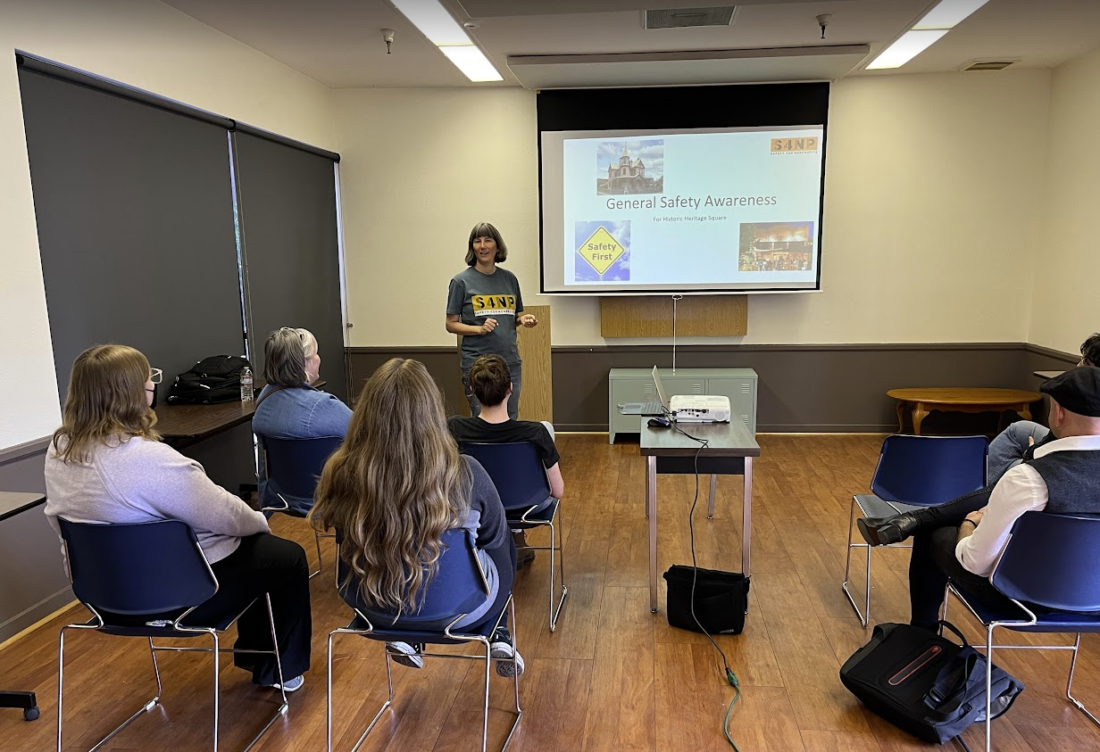


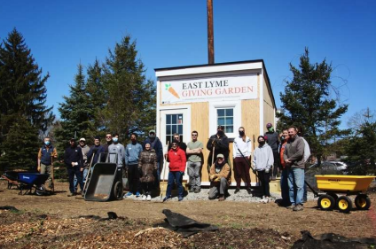
S4NP - Safety For Nonprofits
S4NP volunteers are covered by liability insurance and empowered to contact nonprofits and propose work
If you want to use your skills and make a difference – sign up at S4NP.org

Slide 13
OHTA

Slide 14

WHO IS OHTA?
A not-for-profit charity established and run by a global group of volunteer occupational hygienists who serve as subject matter experts and members of the leadership team.
Offers internationally acclaimed OH training material targeted to the professional technician with in-person and on-line courses offered in over 50 countries with course manuals and on-line exams in multiple languages.
Offers the ICertOHTA qualification and opens a path to the CIH and other national credentials.

Slide 15
ICertOHTA QUALIFICATION
Successful completion of 6 OHTA courses (4 core and 2 optional) leads to the ICertOHTA qualification. This qualification is a notable achievement for early career professionals, and their expertise promotes healthy workforces.
OHTA training modules also count toward the IH/OH coursework requirement for the CIH credential awarded by the Board for Global EHS Credentialing and other credentials offered by national IOHA NAR recognized accreditation schemes.

Slide 16
NEW FROM OHTA IN 2024 HELP FOR STUDENTS IN EMERGING ECONOMIES
With help from OHTA sponsors and supporters, OHTA may adjust the exam fees to support countries where students cannot afford to pay the exam fee.
One exam costs $125 USD/100 £.
This program targets OHTA training courses conducted by IOHA National Associations and other non-profits that offer students low- or no-cost training.
OHTA is seeking donations to help support this program. Please help us help students in emerging economies.

Slide 17

NEW OHTA PATHWAY TO CIH
In 2024, OHTA announced a new partnership with AIHA (aiha.org), Workplace Health Without Borders-US (whwb.org), and the Board for Global Credentialing (gobgc.org) to help qualified applicants in emerging economies achieve the prestigious CIH credential.
Qualified applicants can receive reduced fees for OHTA exams, a mentor to help them prepare for the exam, reduced fee on the AIHA CIH Prep Course, and more.

Slide 18




NEW OHTA PATHWAY TO CIH
OHTA Training
ICertOHTA certificate recognized by BGC and NAR* to help meet:
OH Training requirement for CIH & NAR national association certification
Education Contact Hours as required for CIH
STUDENTS
• Bachelor’s degree or equivalent (accredited university STEM field of study)
• OH Training / ICertOHTA Certificate
• 5 years professional experience
ICertOHTA Certificate
6 Modules including:
4 Core: OHTA501, 503, 505, 507
2 Optional: OHTA502, 504, 506 or 1001
OHTA
Support application sent to OHTA
Successful applications sent to WHWB-US
WHWB-US **
WHWB-US reviews applications
Successful students attend AIHA CIH preparation seminar
Mentors assigned to students for CIH exam preparation support
Reduced CIH preparation course cost
* NAR refers to IOHA national associations offering a certification program.
** WHWB-US may offer financial support to well-qualified students to help pay for CIH Preparation Exam registration and review materials.
BGC CIH Certification

Slide 19

FUTURE PLANS TO CONTINUE OUR MISSION
INDUSTRY-SPECIFIC SPECIALIST COURSES
Mining and Metal Processing Industries (Released January 2025)
Pharmaceutical Industry (In development)
Oil and Gas Industry (In development)
A Generalist EHS Course (planned for the future)
NEW OUTREACH: Develop courses for construction, OH vendors, in-house company training, occupational physicians, and other medical staff. Expand OHTA in South America, India, Canada, and Africa.
COLLABORATIONS: Continue collaborating with BGC, WHWB-US, AIHA, and others to leverage the professional-level qualification.

Slide 20
How AIHA local sectionS can help
OHTA welcomes your donation of any amount whether it’s:
$125 for one exam or
$1,000 for eight exams that put you in our Heroes Circle of OHTA Supporters or
Any amount that suits you.
Contributions in the U.S. are tax-deductible (501(c)(3) EIN 83-2036073).
Payment through Pay Pal is available on the OHTA website at https://ohtatraining.org/support/donate/
Email team@ohtatraining.org with questions.

Slide 21
Local section Resources

Slide 22
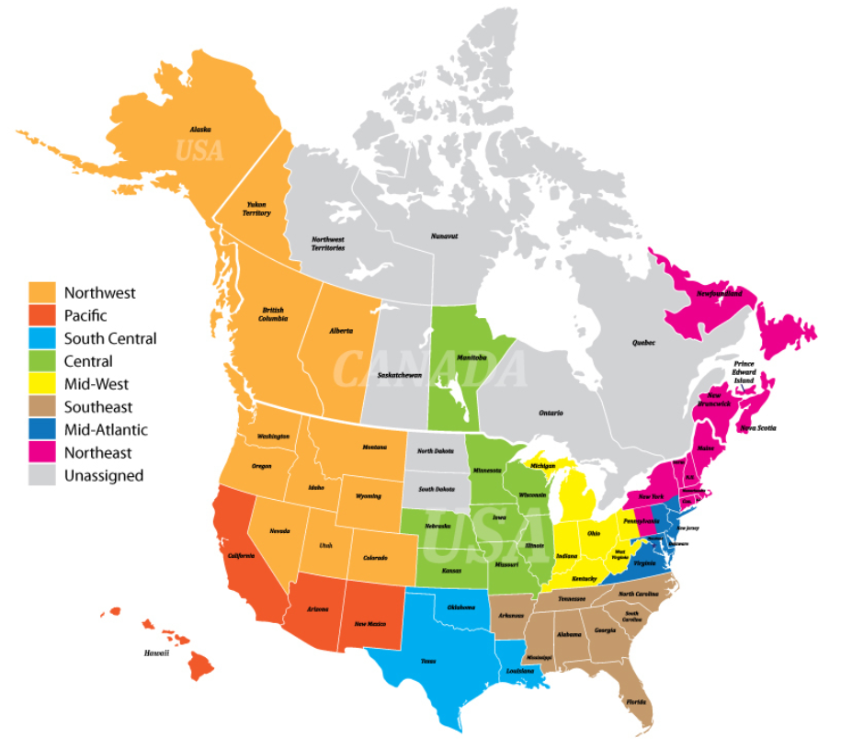
Local Sections / Student local sections
Comprised of 61 Local Sections and 27 Student Local Sections
Each region may have its own special concerns, and the activities of one local section may vary from another. However, the purpose of each local section remains the same:
Increase knowledge of IH/OEHS in a specific region.
Promote the profession and engage with local/regional government, industrial, educational, and other professional bodies.
Share a concern about the health of workers worldwide as well as the special concerns of the regional area.
Recruitment and retention of members (local level and national).
Local Sections | AIHA

Slide 23
Local Section Structure
All Local Section Officers must be AIHA National members in good standing excluding directors.
One year term for officers. Rotation based on Section by laws.
AIHA Board Liaison serves as a link between LSAG and the AIHA Board.
AIHA staff liaison assists with administrative requests.
Smaller local sections, at a minimum, should have a president and a secretary-treasurer.
Board Liaison
Staff Liaison
Director
President
President –Elect
Treasurer
Secretary
Treasurer-Elect
Secretary- Elect
aiha.org | 23
Notes:
First - remember, all officers must be AIHA National members in good standing (excluding directors who may not need to be members of AIHA).
Not all our Local Sections have the structure where all the positions noted are filled. At a minimum each section should have a President, President-Elect, immediate Past President, and a Treasurer/Secretary to operate effectively and efficiently. The smaller local sections must have at a minimum, elected Officers consisting of the President, Treasurer, and Secretary. The positions of Treasurer and Secretary may be combined as deemed by the section with approval of the Board of Directors of AIHA or the Board’s designee
As noted earlier, Joseph Hill on staff is assigned to assist with administrative needs and overseeing LSAG.
And, Eric White serves as Board Liaison (our link between LSAG and the AIHA National’s Board of Directors).

Slide 24
Board Liaison to Local Sections
Communicates with one voice/one message regarding AIHA policies, procedures, and initiatives regardless of personal opinion.
Serves as an advocate for the sections and communicates with the sections following any board action affecting the local sections.
Provide input and guidance on local section-related activities such as governance documents, bylaws, and regional events and meetings.
Attend the AIHA Connect Local Sections Business meeting, and as schedule permits, participate on Local Section Advisory Group (LSAG) calls.
Notes:
Expectations of Board Liaisons:

Slide 25
Staff Liaison to Local Sections
Assists with local section related matters.
Local Section website updates when needed.
Provides officers training.
Maintains the connection between AIHA national and the Local Section network.
Provides monthly dues report.
Assists with speaker travels and reimbursement.
Assists with event sharing & posting.
aiha.org | 25
Notes:
Staff Liaison handles the day-to-day operations of your section and Essentially, they make sure that you’re well-supported in running the section smoothly and assists with all local section related matters.

Slide 26
What AIHA Provides to Local Sections
CEO / AIHA Board members AIHA National updates (NOTE: Board members can also provide a technical talk as well as national updates)
Website hosting upon request
Use of web conferencing system for officer calls (audio component – Microsoft Teams & Zoom)
Speaker Resources / Distinguished Lecturer Reimbursement (up to $600 of travel expenses)
Leadership Development via Leadership Workshop (targeted at the president-elect)
Catalyst online community is available for LS Officers, and for Sections where AIHA National collects membership dues payments
SharePoint site (available to local section officers for record retention)
Dues Renewal Program

Slide 27
What AIHA Provides to Local Sections
Electronic Balloting
Officers Training
LS Business Meeting at AIHA Connect
AIHA Banner Stands and AIHA Handout Materials/Giveaways
Administration of LS Scholarships via AIHF
General Liability Insurance for Meeting Events and Directors / Officers Insurance
Catalyst Officer Community.
Event promotion:
Local section events can be shared on the AIHA website- Events Calendar | AIHA
Promote events through catalyst under the Local Section Officers Community Room
Events can also be promoted to AIHA national members - contact Staff Liaison, Joseph Hill, jhill@aiha.org

Slide 28
2026 e-Learning Subscription program
Launches November 2025
Program Details
Runs January 2026 – December 2026
Access for your roster to up to 24 contact hours of education from the 2026 AIHA University Education Webinars and select AIHA Connect OnDemand recordings.
Roster size | Early Bird Member (through 12/31/2025 | Early Bird Non-member ((through 12/31/2025) | Standard Member (after 1/1/2026 | Standard Non-member (after 1/1/2026
Individual Subscription | $450.00 | $750.00 | 499.00 | $799.00
Rosters up to 25 | $1,800.00 | $2,400.00 | 2,100.00 | $2,700.00
Rosters up to 50 | $2,010.00 | $2,670.00 | 2,310.00 | $2,970.00
Rosters up to 100 | $2,115.00 | $2,805.00 | 2,415.00 | $3,094.20
Rosters up to 150 | $2,220.00 | $2,940.00 | $2,520.00​ | $3,240.00
Rosters up to 200 | $2,325.00 | $3,075.00 | 2,625.00 | $3,375.00
Rosters up to 300 | $2,535.00 | $3,210.00 | 2,833.80 | $3,510.00
Rosters up to 400 | $2,745.00 | $3,345.00 | 3,042.60 | $3,645.00
Rosters up to 500 | $2,955.00 | $3,480.00 | 3,251.40 | $3,780.00
.aiha.org/education/elearning/elearning-subscription

Slide 29
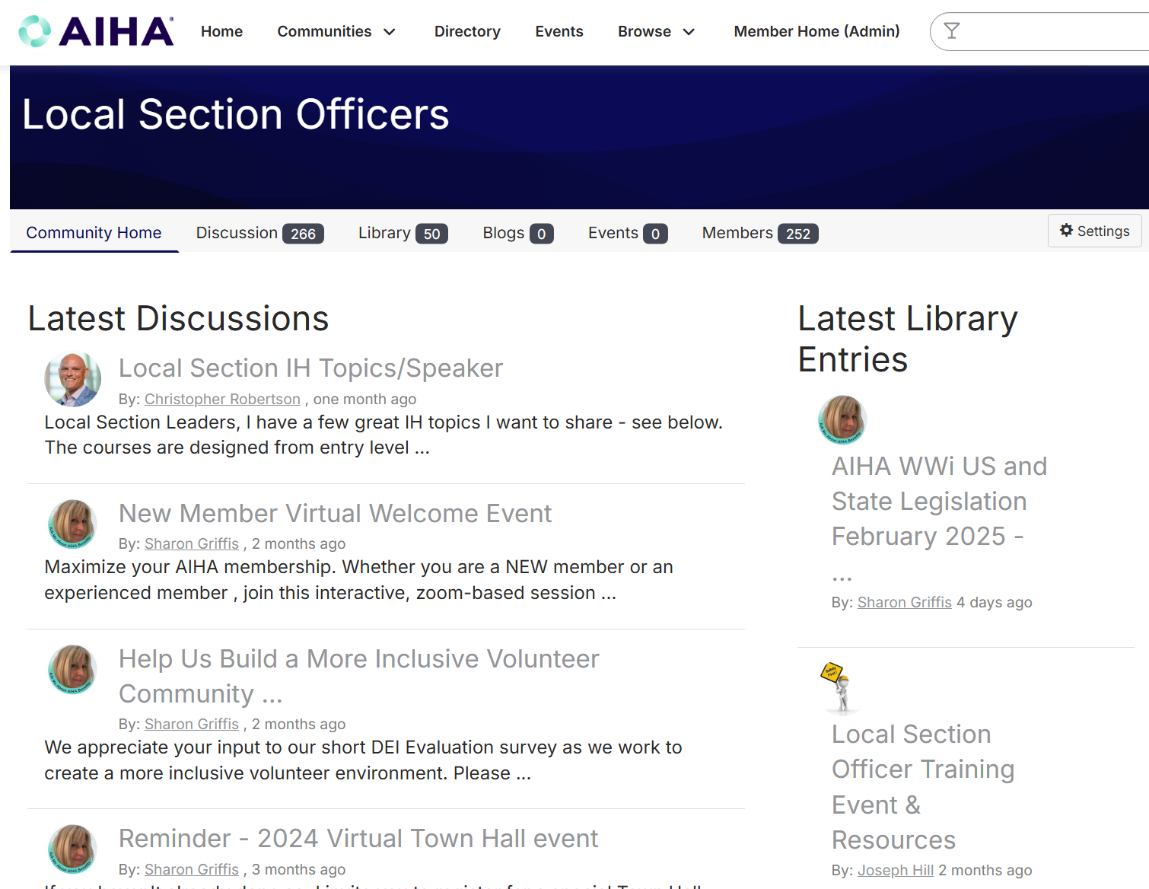
Catalyst LOCAL SECTION OFFICER COMMUNITY
Improved features, allowing you to easily access all relevant community information right from the homepage.
Profile preferences and notification management.
Library management and storage.
Communicate directly with other officers.
Notes:
Topics to cover:
The Local Section Officer Community Room
Privacy settings

Slide 30
IMPORTANT RESOURCES
Online Operations Manual
Forms
Operations
Policies
AIHA National Support and Benefits of your Local Section Membership
Local Section monthly updates – available on Catalyst
Distinguished Lecturer Program | AIHA
www.aiha.org/get-involved/local-sections

Slide 31
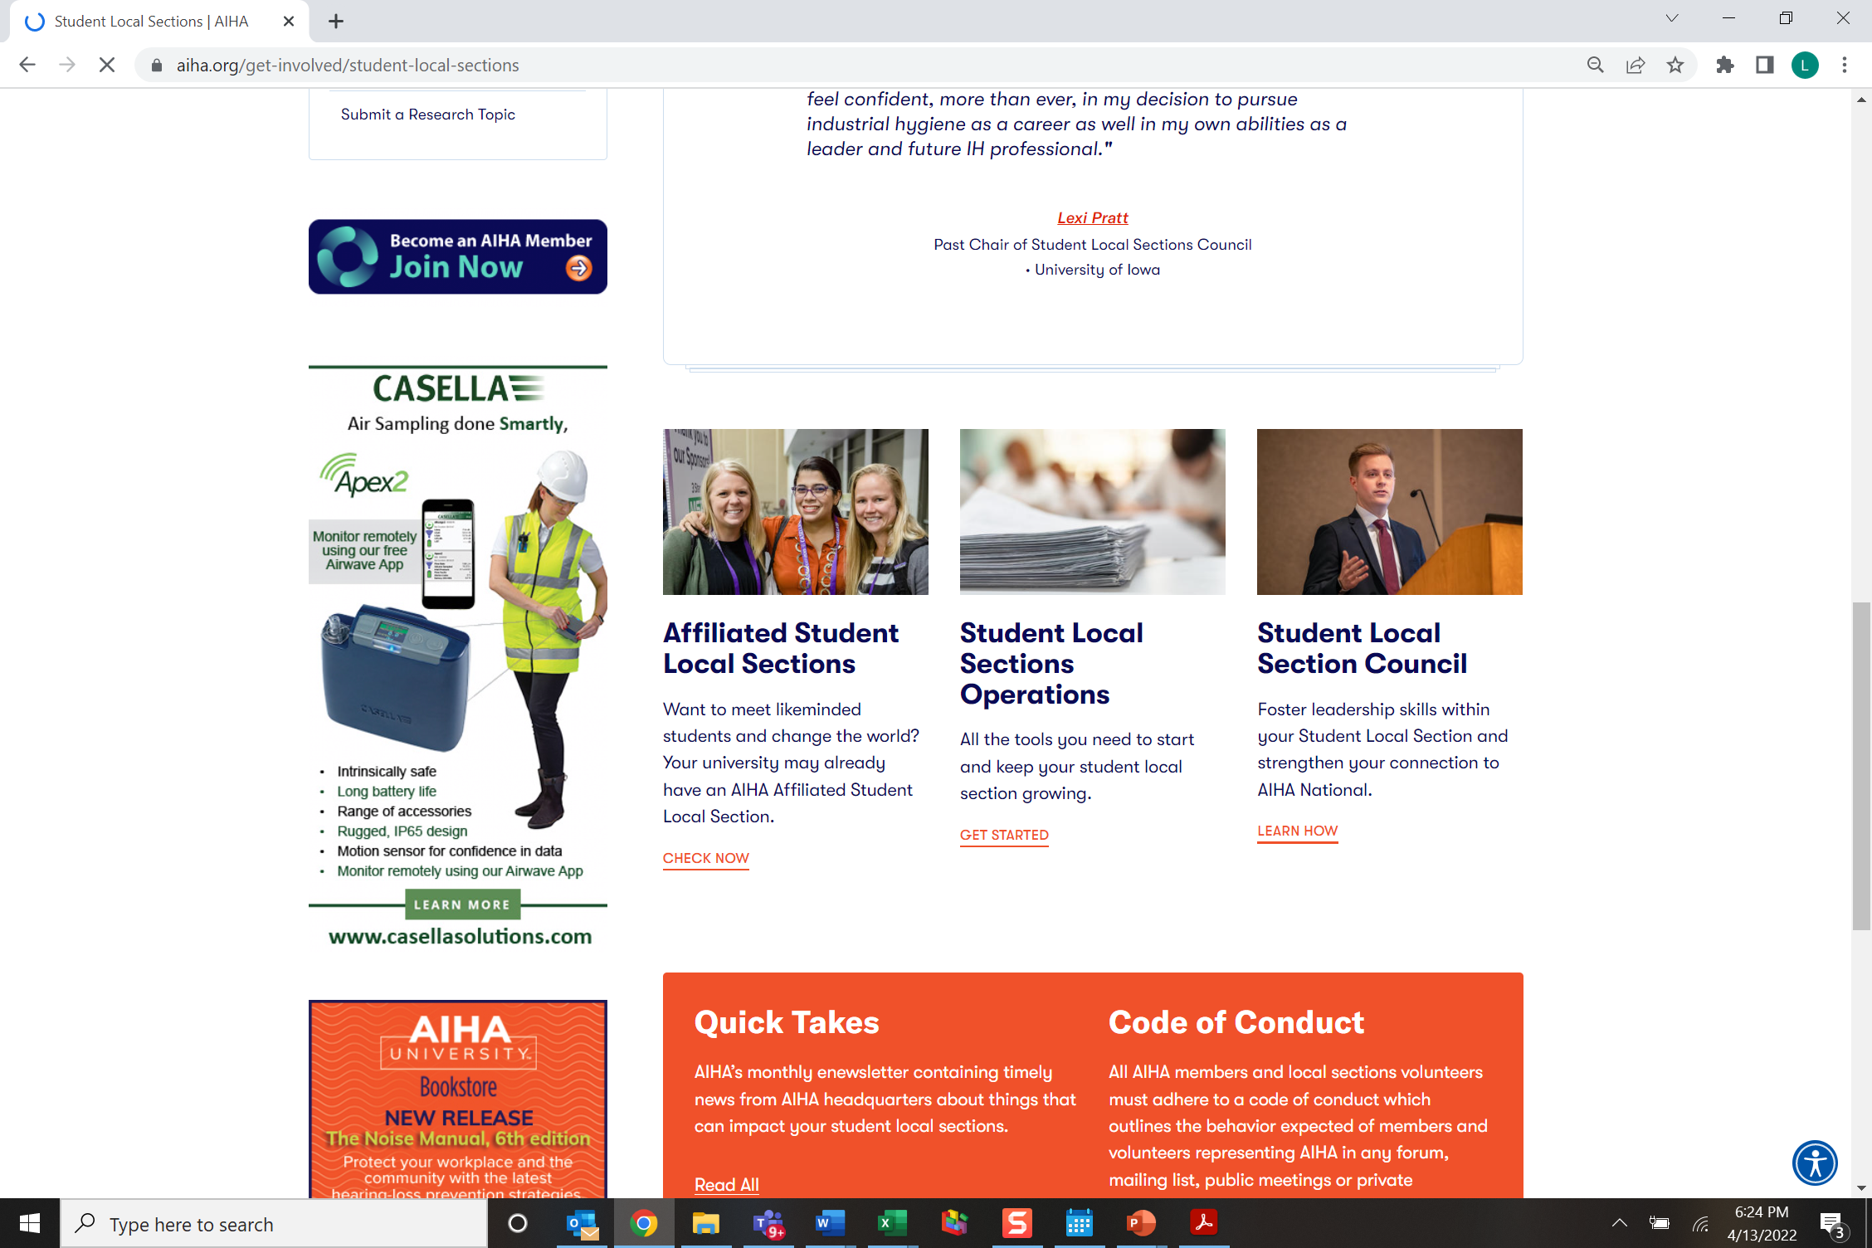
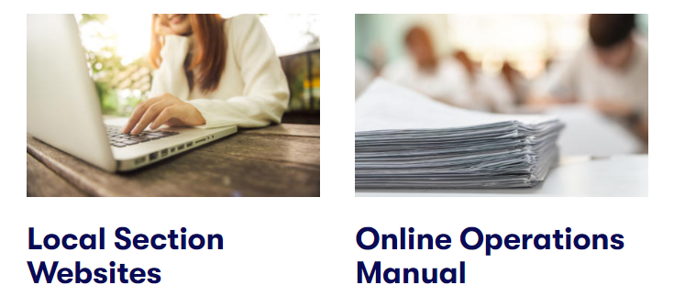
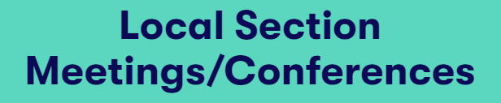
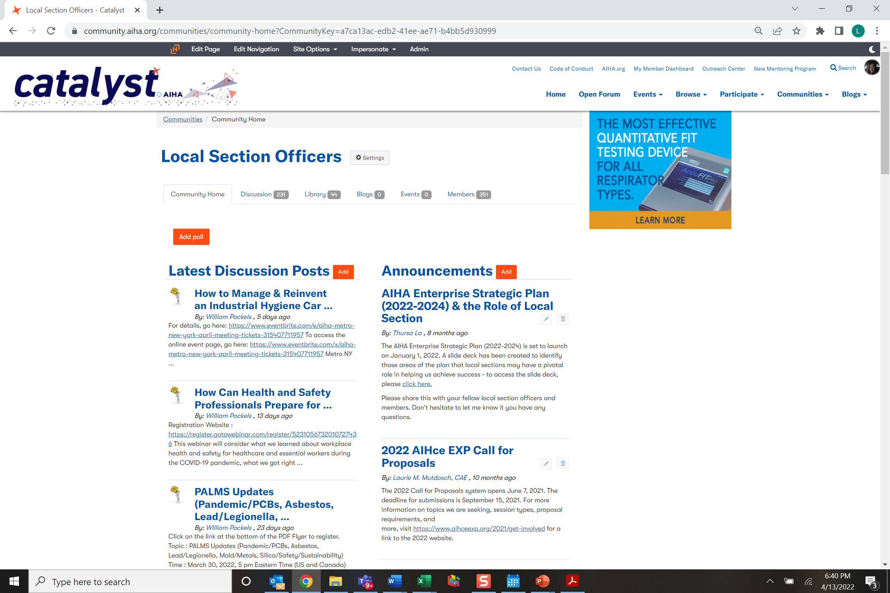
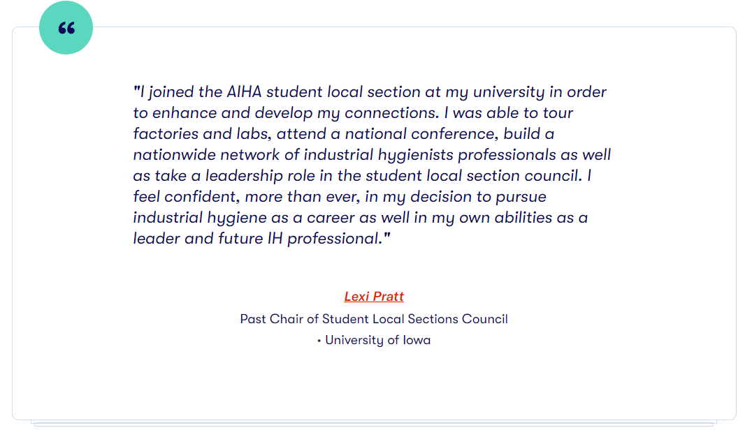
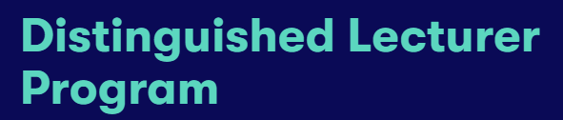
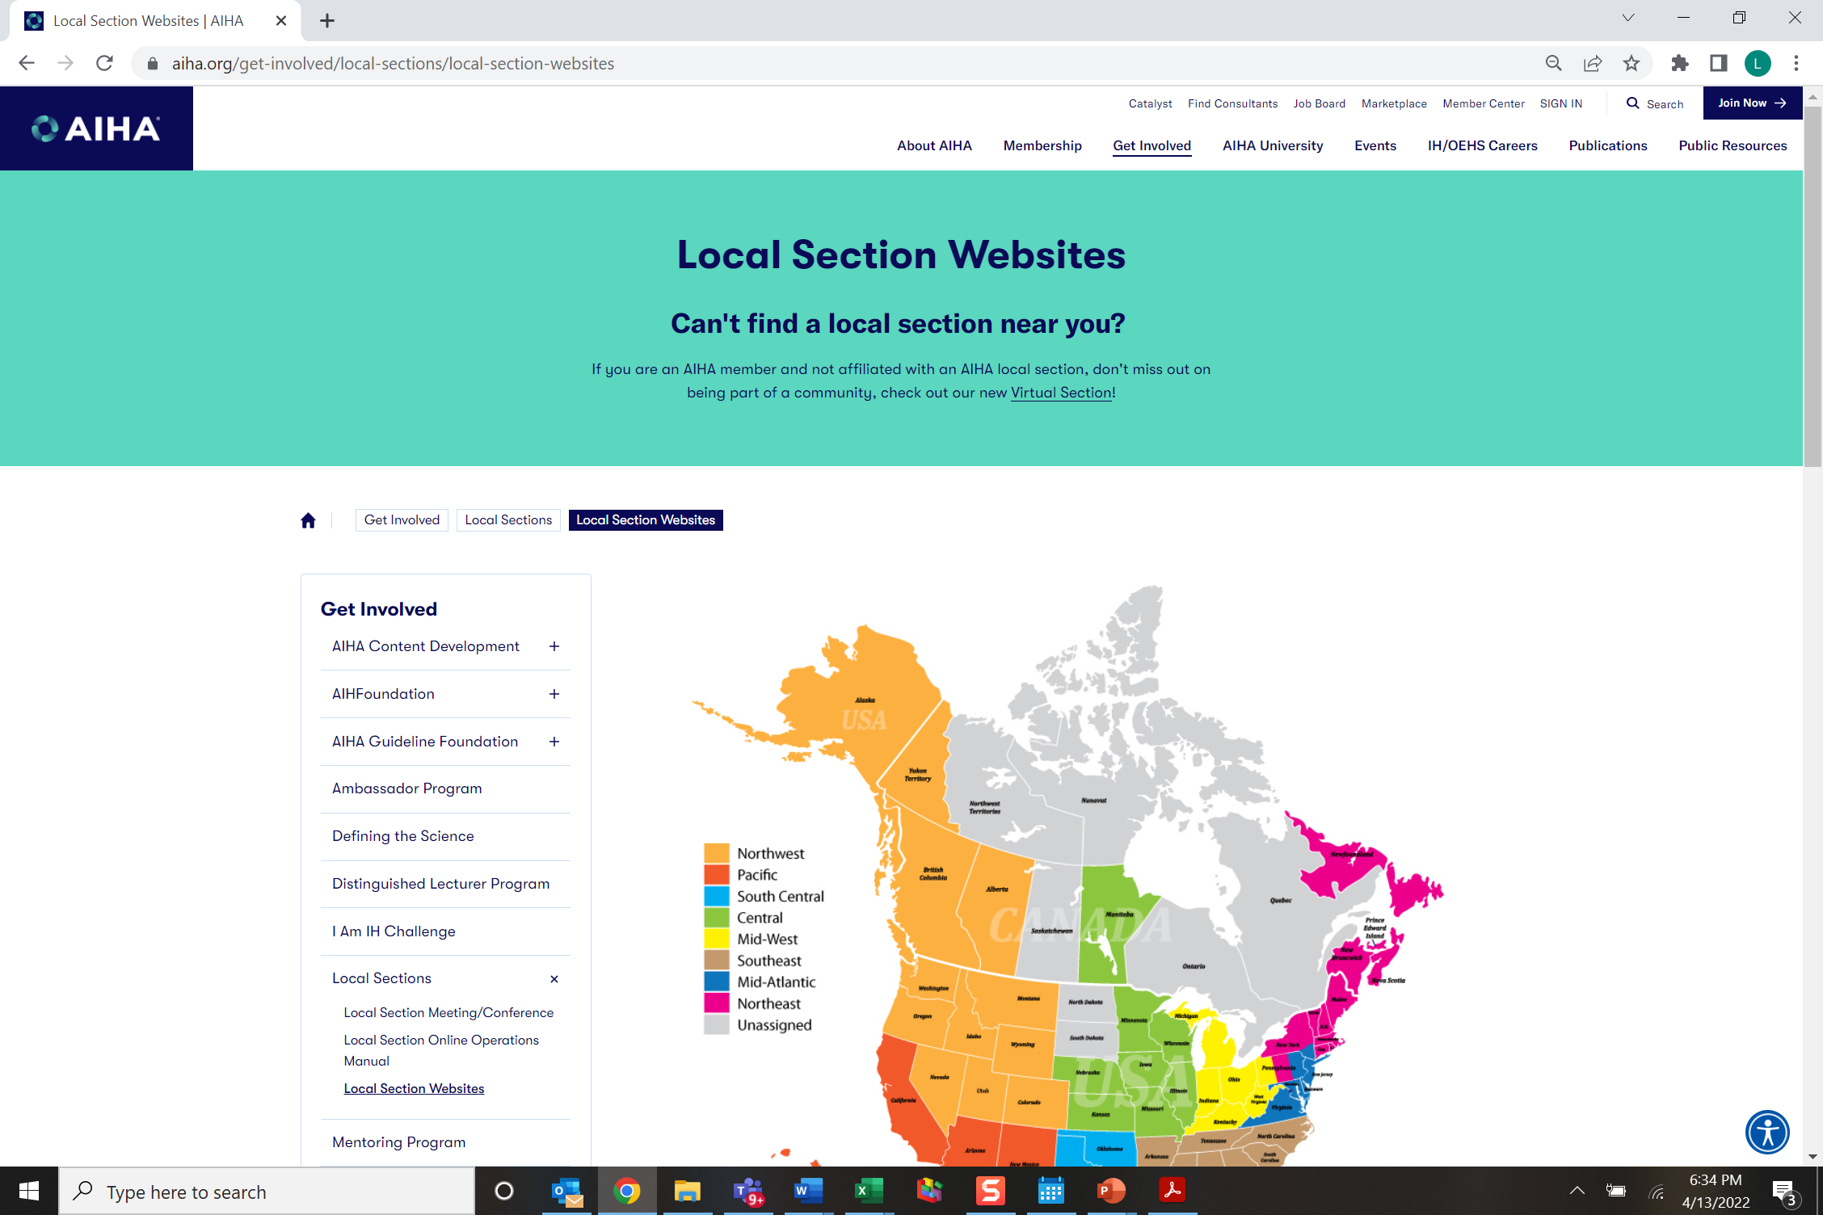
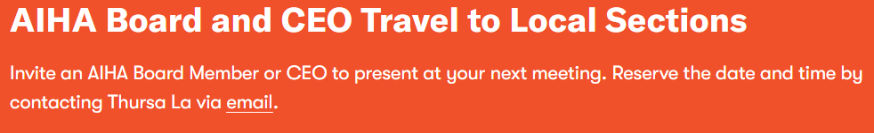
Support of local / Student sections

Slide 32

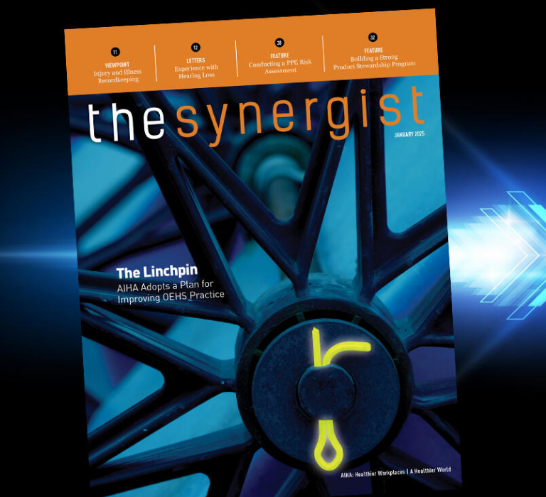
The value of aiha national Membership
Exclusive Resources like the Synergist Magazine
Deep Discounts on AIHA Connect, Connect OnDemand, and eLearning Subscription
Networking
Catalyst Community
AIHA University Discounts on Education and CM Maintenance
AIHA Consultants Listing and Directory
Leadership Development, including the Mentoring Institute
Career Development, including Career Advantage
Opportunities to Shape and Advocate for OEHS
Access to Liability Insurance
Join AIHA | AIHA
Notes:
A plethora of member benefits across community, connections, leadership, advancement, education, knowledge, training, development:
Our award-winning publications, exclusive webinars, research priorities, online community, mentoring program, career pathways, and so much more have kept us on the front lines of protecting worker health and safety.​

Slide 33






Connect now!
Look for exclusive AIHA information, updates, and offers
Follow us for important industry news and happenings
Join the discussion with other like-minded professionals
Check out AIHA Network TV video series, and view popular uploads
Get more Information at aiha.org
Check out great offers and product specials.

