Slide 1


AIHA Exposure Assessment Strategy and resources
Presentation for Academic Training Programs
>> Insert presenter title and applicable designations/badges

Slide 2
PRESENTATION OVERVIEW
Background on AIHA Initiatives and PGP
Bayesian Statistics
Advantages for Academic Programs
Resources

Slide 3
BACKGROUND ON AIHA INITIATIVES
AIHA and ACGIH have developed an initiative, to drive a significant shift in the OEHS practice paradigm: where the use of tools and activities to improve exposure judgment accuracy is routine and expected.
Studies have shown that the accuracy of industrial hygiene exposure judgments is often poor, sometimes not statistically different from random chance, and tends to be biased low^{1,2,3}.
1: Logan, P., G. Ramachandran, J. Mulhausen and P. Hewett. (2009). Occupational exposure decisions: can limited data interpretation training help improve accuracy? Annals of occupational hygiene, 53(4), 311-324.
2: Vadali, M., G. Ramachandran, J. Mulhausen, and S. Banerjee: Effect of training on exposure judgment accuracy of industrial hygienists. J. Occup. Environ. Hyg. 9(4):242–256 (2012).
3: Arnold, S. F., Stenzel, M., Drolet, D., & Ramachandran, G. (2016). Using checklists and algorithms to improve qualitative exposure judgment accuracy. J. Occup. Environ. Hyg., 13(3), 159-16

Slide 4
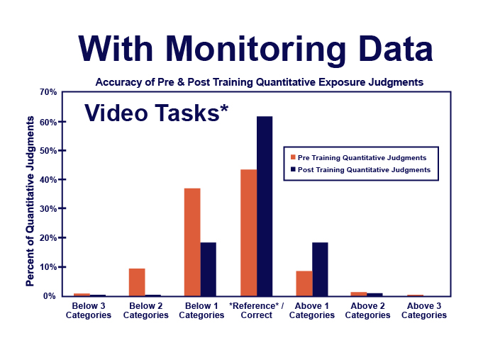
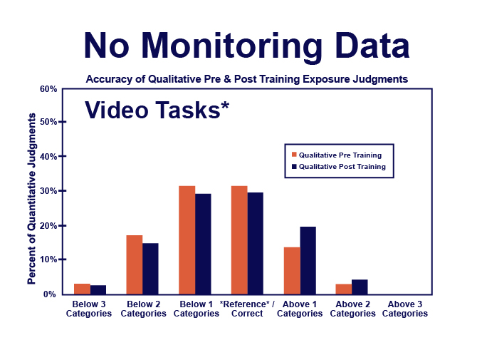
POOR ACCURACY & UNDERESTIMATION BIAS:
Why modeling and statistical tools are necessary.
4
Notes:
Studies have found that experienced hygienists tend to underestimate exposures performing worse than random chance, yet when trained on the use of modeling and statistical tools their accuracy dramatically increased. The use of modeling tools improved the performance of novice hygienists as well showing the importance of learning these tools for early career professionals as well.

Slide 5
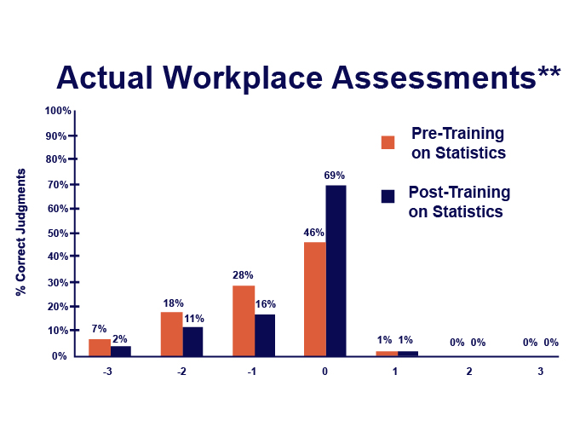
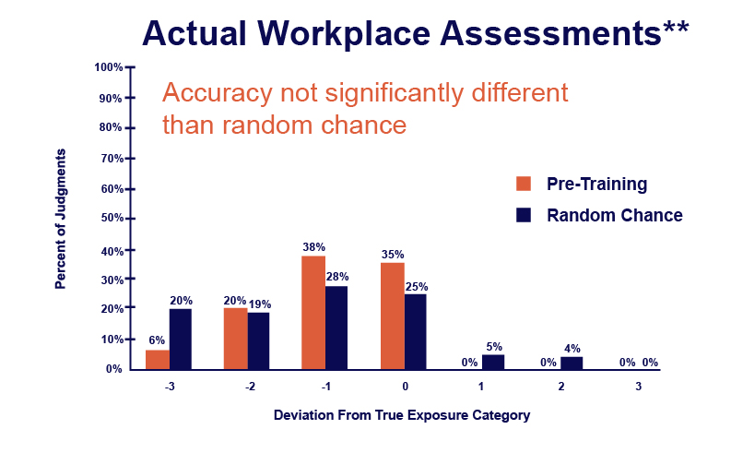
POOR ACCURACY & UNDERESTIMATION BIAS:
Why modeling and statistical tools are necessary.
5
5
5
Notes:
Studies have found that experienced hygienists tend to underestimate exposures performing worse than random chance, yet when trained on the use of modeling and statistical tools their accuracy dramatically increased. The use of modeling tools improved the performance of novice hygienists as well showing the importance of learning these tools for early career professionals as well.

Slide 6
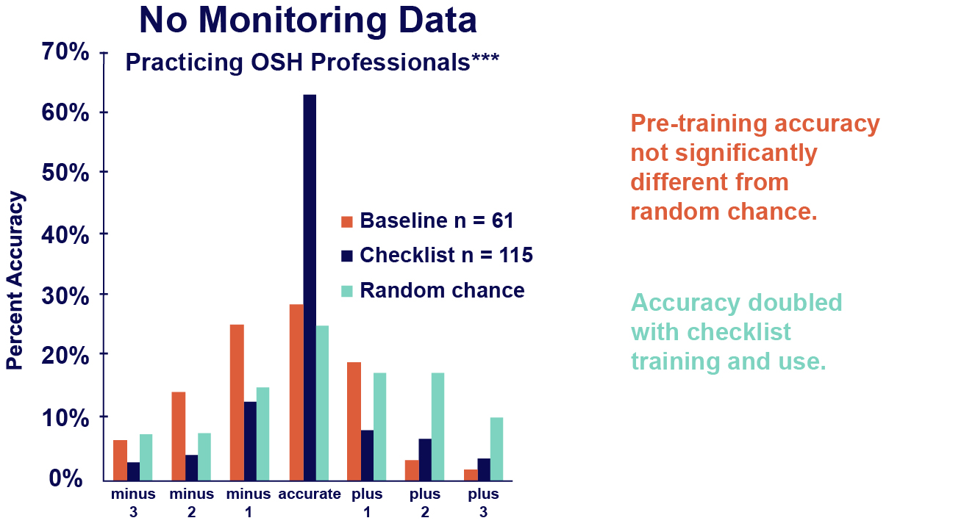
POOR ACCURACY & UNDERESTIMATION BIAS:
Why modeling and statistical tools are necessary.
6
6
6
Notes:
Studies have found that experienced hygienists tend to underestimate exposures performing worse than random chance, yet when trained on the use of modeling and statistical tools their accuracy dramatically increased. The use of modeling tools improved the performance of novice hygienists as well showing the importance of learning these tools for early career professionals as well.

Slide 7




principles of good practice
Download Today:
https://www.aiha.org/get-involved/volunteer-groups/advancing-the-science-and-practice/principles-of-good-practice
Notes:
PGP is about going above and beyond regulatory compliance
It documents good and enhanced performance practices based on published AIHA guidance, organized by rubric (or technical topic area).

Slide 8
Overview: Occupational Exposure Assessment PGP
PGP Section | Selected Key Content
Scope & Objectives | Assess and control all chemical, physical and biological exposures for all workers across all workdays
Program Management | Written program Under direction of an industrial hygienist experienced and trained in exposure assessment
Basic Characterization | Critical information for characterizing exposures is documented for the workplace
Occupational Exposure Limits | Authoritative or internal OELs are used for exposure judgments Regulatory OELs are used if lower than authoritative or internal OELs
SEGs | The workforce is stratified into similar exposure groups (SEG).
Exposure Judgments | Exposure are acceptable if the 95th percentile is less than the OEL with 70% confidence (95% confidence best practice) An AIHA Exposure Category (EC) and certainty rating are selected for each air contaminant and noise SEG The exposure profile for each SEG is judged acceptable or unacceptable
Notes:
This is the first of two slides listing the content of the PGP. Here we see:
Scope and Objectives are to control all exposures for all workers across all workdays.
Program management including a written program
Basic Characterization of exposure scenarios
Utilization of OELs
Establishing SEGs – Groups of workers who perform similar tasks, use similar materials or equipment, work under comparable conditions, and are expected to have similar exposure levels to a particular hazard
Establishing Standards for Exposure Judgments
Authoritative OELs Set by expert organizations (e.g., ACGIH, NIOSH) based on scientific research. These are not legally binding but are widely respected and used as benchmarks for workplace safety.
Regulatory OELs Legally enforceable limits established by government agencies (e.g., OSHA in the U.S.). Employers are required by law to comply with these standards.
Internal OELs Company-specific limits developed by organizations to protect workers, often more conservative than regulatory or authoritative limits. These reflect a company’s own risk management policies or ethical standards.
AIHA Exposure Category classification of exposure levels based on how they compare to occupational exposure limits (OELs).
Category 1 < 10% of OEL
Category 2 10–50% of OEL
Category 3 50–100% of OEL
Category 4 > 100% of OEL

Slide 9
Overview: Occupational Exposure Assessment PGP
PGP Section | Selected Key Content
Monitoring Practices | 3+ baseline samples are collected for each SEG initially rated EC of 2 or 3 Baseline sample data are analyzed using statistics to update the exposure category and the certainty rating 3+ additional baseline samples are collected for SEGs with updated EC of 2 or 3 having low or medium certainty
Non-recurring Ops | Non-recurring operations are anticipated, prospectively assessed, and controlled
Health Hazard Controls | Initially, SEGs judged unacceptable are quickly controlled Enhanced permanent controls (higher on the hierarchy) are sought in a prioritized manner
Med. Surveillance | Med. surveillance is provided to workers in EC 3 and 4 where protocols are available
Com. & Training | Findings and recommendations are reported in an effective and timely fashion
Reassessments | Management of change procedures are established to provide notification of newly planned changes in the workplace, workforce, or environmental agents
Standard Controls | Standard control approaches are considered in the exposure assessment process
Perf. Meas. | Performance measures are identified, tracked, and communicated to stakeholders
Recordkeeping | Exposure assessment records are maintained indefinitely
Notes:
This remaining main elements of the PGP are displayed here and include.
Statements regarding Monitoring Practices:
Assessments related to Non-recurring operations
Establishing exposure controls
Medical Surveillance based on exposure
Communication & Training associated with exposure potential
Reassessment based on findings or changes to workforce / process
Establishment of recognized control practices
Establishment of performance measures and,
Record content / maintenance

Slide 10

What are you doing now?
How are statistics integrated into the occupational health curriculum currently?

Slide 11
IH STATISTICS VS. BIOSTATISTICS
Focus on lognormal (vs normal) distribution parameters and data analysis
Bayesian statistics including restricted parameter space and priors with small datasets - uses information known about occupational exposures to enhance data analysis of small datasets
Current sampling and analysis guidance frameworks such as AIHA, EN689, or BOHS
Use of IH specific tools such as IHSTAT or Expostats as opposed to SPSS

Slide 12
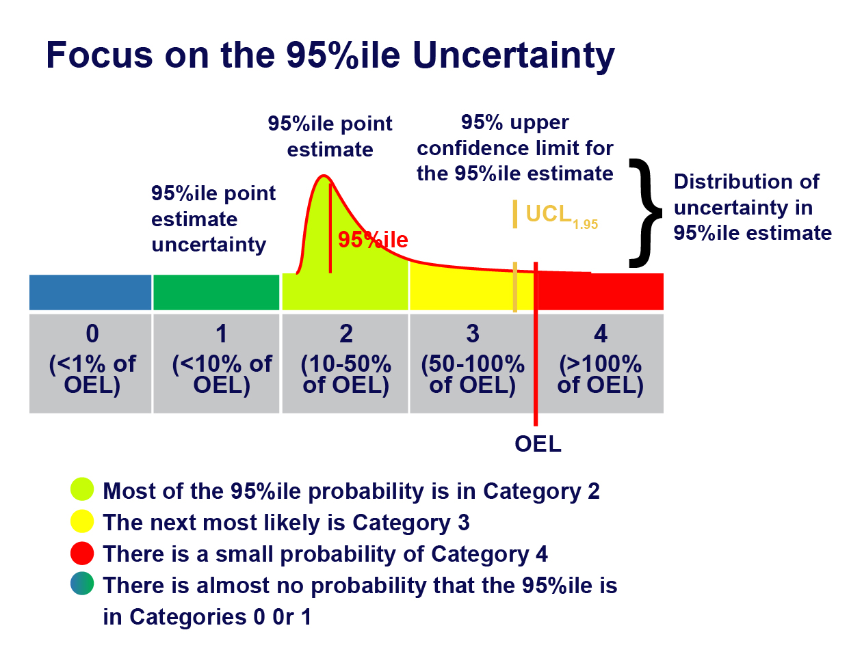
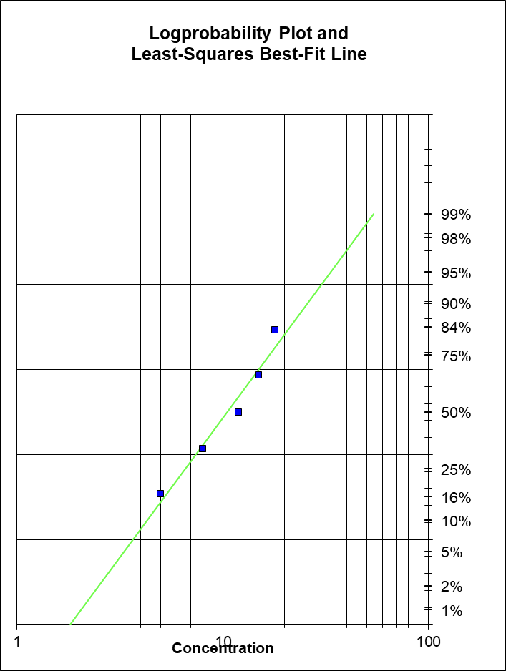
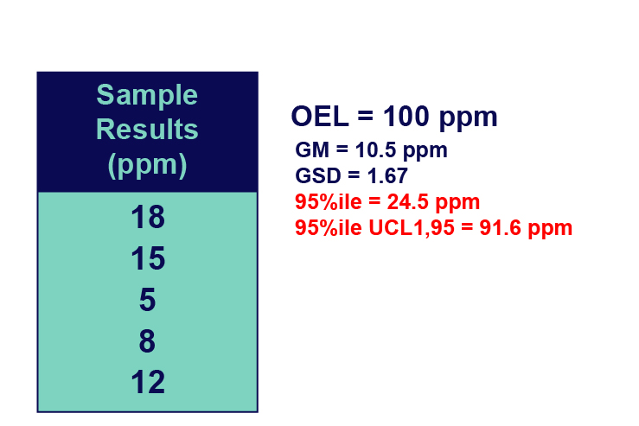
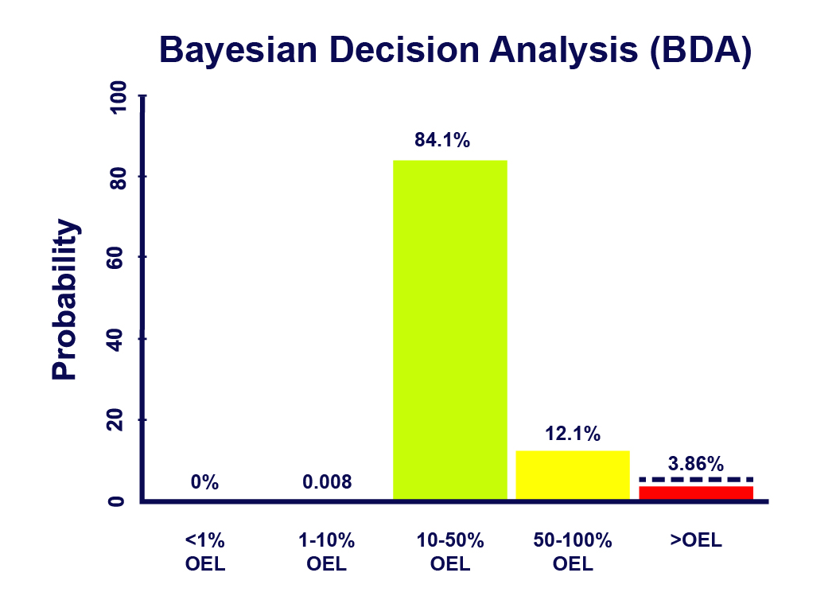
Notes:
To perform statistics, AIHA recommends the collection of 6-10 samples per similar exposure group, with an acceptability criteria of <30% risk that the 95th percentile exceeds the exposure limit.
The 95th percentile is a measure of the upper end of exposures. This can be compared to the OEL to ensure even at the high end of exposure variability we are protecting workers.
Exposure control categories can be used to standardize what follow-up actions are taken.

Slide 13
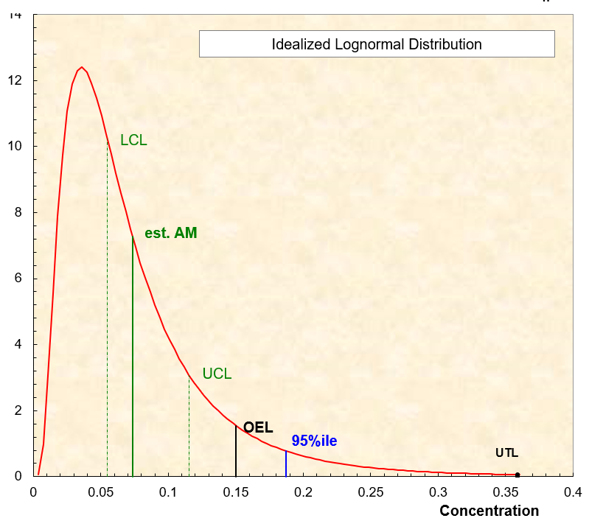
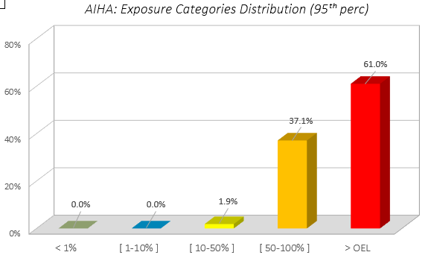
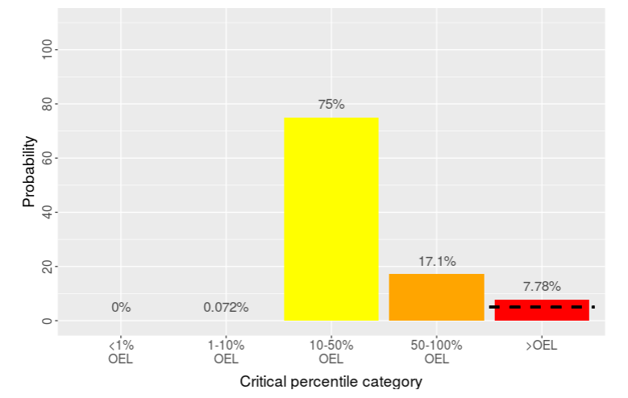
Traditional Statistics
Bayesian Statistics
IHDA-AIHA
IHSTAT-Bayes
Multi-Language
AIHA IHSTAT©
Expostats
Macro-Free
Notes:
Traditional frequentist statistics will provide important outputs such as an estimate of the 95th percentile to a certain level of confidence.
Bayesian tools calculate the 95th percentile as well, however, use information about the variability of worker exposures to refine the estimate, and also provide probabilities that the true 95th percentile falls within certain ranges of the OEL.
Bayesian tools provide improved handling of censored data over frequentist statistics as well.

Slide 14
Likelihood
Likelihood
1
0.664
1
0.709
0.8
0.8
0.6
0.6
0.256
Decision Probability
0.191
Decision Probability
0.4
0.104
0.041
0.4
0.035
0
0
0
0.2
0.2
0
0
0
1
2
3
4
0
1
2
3
4
Exposure Rating
Exposure Rating
 | Exposure Rating Category** | Recommended Control
 | 0 (<1% of OEL) | No action
 | 1 (<10% of OEL) | Procedures and Training; General Hazard Communication
 | 2 (10-50% of OEL) | + Chemical Specific Hazard Communication; Periodic Exposure Monitoring,
 | 3 (50-100% of OEL) | + Required Exposure Monitoring, Workplace Inspections to Verify Work Practice Controls; Medical Surveillance, Biological Monitoring
 | 4 (>100% of OEL) | + Implement Hierarchy of Controls; Monitoring to Validate Respirator Protection Factor Selection.
 | Multiples of OEL (>500% of OEL or others based on respirator APF) | +Immediate Engineering Controls or Process Shut Down, Validate Acceptable Respirators
Notes:
Utilize statistics to address and update controls.

Slide 15
Advantages for Academic programs
Operationalize knowledge into actual practice:
Practical skills so that the students are successful when they graduate.
Ensure that the students know how to practically implement what they learn.
Emphasize effective and efficient and systematic – increase students’ ability to get the job done – Best way to use limited resources.
Making good decisions the first time – Data Interpretation Exercise

Slide 16
Advantages for Academic programs
Help students differentiate themselves in the job market:
EDA as “the extra mile” that makes them stand out.
Job postings starting to emphasize stats. – Need to train them!
International students have more emphasis on stats. Need to train them!
Great feedback loop regarding well trained students out of specific programs.

Slide 17
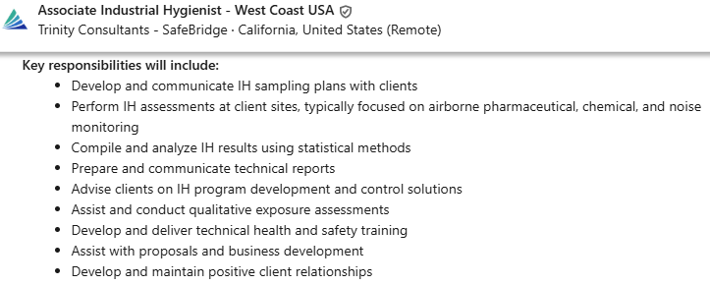
Advantages – employment opportunities
Help students differentiate themselves in the job market.

Slide 18
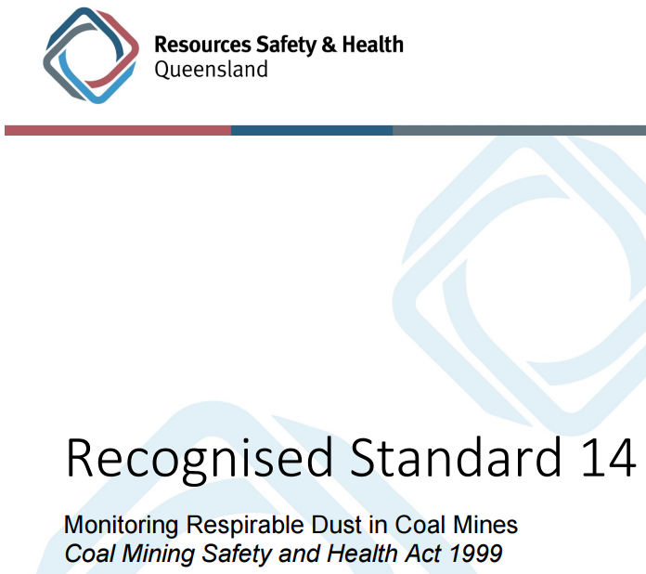
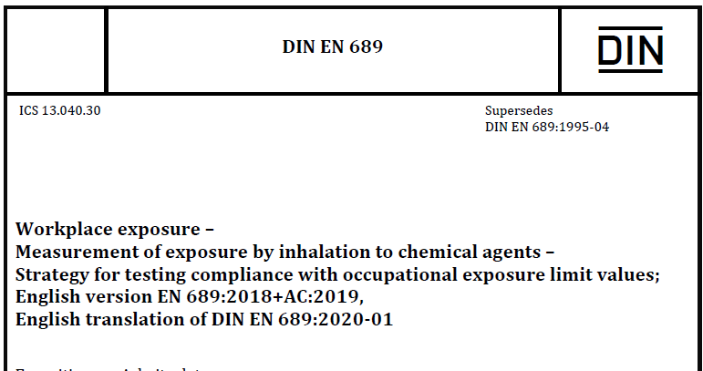

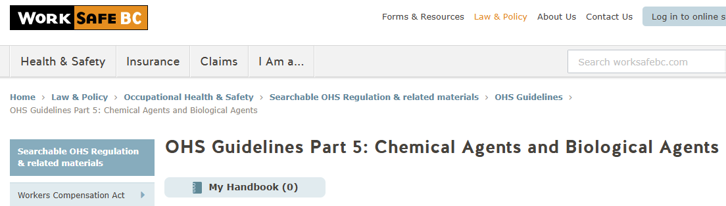
Advantages – international work
International standards require statistics knowledge.

Slide 19

Advantages – instruction ready to go
Improving Exposure Judgments – Free from AIHA University
https://www.aiha.org/education/elearning/online-courses/making-accurate-exposure-risk-decisions

Slide 20
Advantages:
EXPOSURE DECISION ANALYSIS (EDA) REGISTRY
Benefits Include:
Independent validation of your knowledge, skills and performance in making accurate exposure decisions based on monitoring data.
Recognition of your competency in rendering accurate decisions about worker exposure and exposure uncertainty.
Improve the overall quality of your management of workplace exposures.
Requirements (No Prerequisites)
Score ≥70% on first exam based on the knowledge needed to accurately interpret exposure monitoring data.
Score ≥70% on second exam based on the correct interpretation of supplied data sets.
Affirm a commitment to continuous improvement.
Registration is valid for 5 years
Free Assessment of the Knowledge, Skills and Performance Needed to Accurately Interpret Exposure Monitoring Data

Slide 21
Our goals with this initiative
Students leave academic programs knowing:
  IH specific statistical concepts
  Effective approaches for exposure decision making
  Standards and guidelines
  How to use analysis tools
  Where additional resources can be found
Professors have resources to incorporate into programs and update

Slide 22

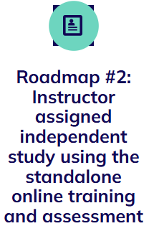
HOW CAN WE HELP YOU?
Subject matter expert support
Course content development
Existing roadmaps for integration into academic programs
https://www.aiha.org/public-resources/aiha-academic-portal/resources-for-academics/topic-1---improving-exposure-judgments-an-introduction-to-ih-statistics

Slide 23
Additional Resources
Books:
  A Strategy for Assessing and Managing Occupational Exposures. 4th Ed. AIHA Press. 2015.
Opinion:
  Mulhausen, J. “Faulty Judgment” President’s Message. The Synergist. (November 2021).
  Access HERE
  Mulhausen, J. “How to Improve Exposure Judgments” President’s Message. The Synergist. (December 2021). Access HERE
  Mulhausen, J. “Standards of Care: Competence PLUS Performance” President’s Message. The Synergist. (January 2022). Access HERE
  Mulhausen, J. “Acknowledging and Addressing Our Blind Spots” President’s Message. The Synergist. (March 2022). Access HERE
  Martin, K., Murphy, M. and Taruru S. “How “Professional” Is Professional Judgment?” Viewpoint. The Synergist. (December 2022). Access HERE

Slide 24
Additional Resources
Papers – Improving Exposure Decision Accuracy
  Logan P., G. Ramachandran, J. Mulhausen, S. Banerjee, and P. Hewett “Desktop Study of Occupational Exposure Judgments: Do Education and Experience Influence Accuracy?” Journal of Occupational and Environmental Hygiene, 8:12, 746-758, 2011.
  Logan P., G. Ramachandran, J. Mulhausen, and P. Hewett:” Occupational Exposure Decisions: Can Limited Data Interpretation Training Help Improve Accuracy?” Annals of Occupational Hygiene, Vol. 53, No. 4, pp. 311–324, 2009.
  Vadali, M. G. Ramachandran, J. Mulhausen, S. Banerjee, "Effect of Training on Exposure Judgment Accuracy of Industrial Hygienists”. Journal of Occupational & Environmental Hygiene. 9: 242–256, 2012.
  Arnold S., M. Stenzel, D. Drolet, G. Ramachandran; “Using Checklists and Algorithms to Improve Qualitative Exposure Judgment Accuracy” Journal of Occupational and Environmental Hygiene, 13, 159-168, 2016

Slide 25
Additional Resources
Papers - Bayesian Statistical Data Analysis :
  Hewett, P., Logan, P., Mulhausen, J., Ramachandran, G., and Banerjee, S.: “Rating Exposure Control using Bayesian Decision Analysis”, Journal of Occupational and Environmental Hygiene, 3: 568–581, 2006
  Jérôme Lavoué, Lawrence Joseph, Peter Knott, Hugh Davies, France Labrèche, Frédéric Clerc, Gautier Mater, Tracy Kirkham, “Expostats: A Bayesian Toolkit to Aid the Interpretation of Occupational Exposure Measurements”, Annals of Work Exposures and Health, Volume 63, Issue 3, April 2019, Pages 267–279

