Slide 1




Better Exposure Risk Decisions
For more effective and efficient risk management
AIHA Local Section Introduction
Month 2026
SPEAKER NAME & EMAIL ADDRESS

Slide 2
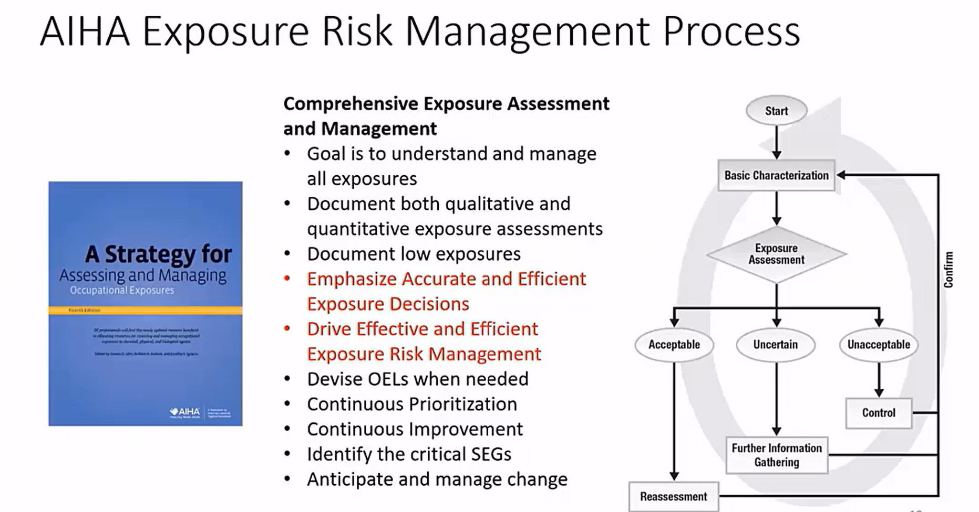
AIHA Exposure Risk management process
Comprehensive Exposure Assessment
and Management
Goal is to understand and manage all exposures
Document both qualitative and quantitative exposure assessments
Document low exposures
Emphasize Accurate and Efficient Exposure Decisions
Drive Effective and Efficient Exposure Risk Management
Devise OELs when needed
Continuous Prioritization
Continuous Improvement
Identify the critical SEGs
Anticipate and manage change

Slide 3
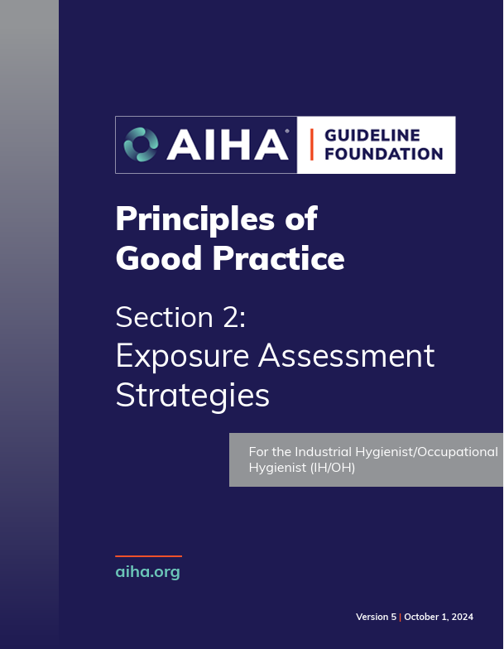

What do we want?
Understand and apply the AIHA exposure assessment strategy
Use statistics as the basis for exposure judgements
Follow the Principle of Good Practice!
How many
of us do this?

Slide 4
Why is this important?
Data Interpretation Survey:
8-Hr TWA results for 5 operations.
    All samples collected correctly (good data)
    Xylene OEL = 100 ppm
Rate as acceptable or unacceptable:
 | Data (ppm) | Acceptable ?
1 | 21,68 | Y / N
2 | 21,109, 38,41,48 | Y / N
3 | 21,16,21,24 | Y / N
4 | 5 | Y / N
5 | 8,70,5,37,12 | Y / N

Slide 5
Variation??
Was there variation in interpretation of results?
    Why the Inconsistencies?
    Different Decisions = Different Levels of Care
    (different levels of exposure risk)
Who are the experts in this area??
    If we aren’t consistent, what are Industrial Hygienists good for?
Exposure Assessment is a Key Competency!!!

Slide 6



What's In it for me?
My work isn't the same everyday, are you sure
I'm protected?
Are you sure their exposure levels are acceptable?
…even when you're not looking?
Be sure: aiha.org/IEJ

Slide 7
Discover the many benefits of
Improved Exposure Judgements
For workers. For workplaces. For you.
When you take steps to strengthen your own exposure risk decisions, by bringing easy to use, free statistical tools and other approaches into your daily practice, you’ll discover a wide range of benefits.
    Better Protection of Workers & Communities through improved judgements that lead to safer workplaces.
    Increased Confidence in your own judgements, with verifiable data analysis to inform and validate your assessments.
    Stronger Communication with your colleagues and clients.
    Greater Efficiencies in assessing risk that require less time and money, and fewer samples than you might think.
Notes:
Studies have shown the current approaches to exposure judgements tend to underestimate the risk to workers. That is why AIHA is committed to helping you elevate your risk assessment abilities by offering FREE access to the education, software, and resources you need to imp[rove the accuracy of your exposure judgements.
By learning about these approaches and applying them in your own work setting, you’ll take important steps toward protecting workers and strengthening your skillset as an OEHS professional.

Slide 8
Why Does this Matter?
When IHs don’t use the tools to analyze the data, we make the wrong decisions.
    Using the statistical tools gives more certainty in our exposure judgment.
This is really a quality control issue.
    AIHA Exposure Control Categories determine the quality of the work environment.
The good news – management understands industrial process quality control methods.
    We can use a small number of measurements, to make a defensible “quality control” judgment.
 | Exposure Rating** | Follow Up / Exposure Control
0 | <1% of OEL | no action
1 | <10% of OEL | general HazCom
2 | 10-50% of OEL | + chemical specific HazCom
3 | 50-100% of OEL | + exposure surveillance, medical surveillance, work practices
4 | >100% of OEL | + respirators & engineering controls, work practice controls
5 | Multiples of OEL | + immediate engineering controls or shutdown, validate respirator selection

Slide 9
What if our exposure assessment is wrong?
If we underestimate the exposure?
Increased risk to employees
If we overestimate the exposure?
Unnecessary expenditures for controls
Unnecessary constraints for employees and production
Well-Designed Exposure Risk Management Strategy
We Want: | We Don't Want:
Good Data | Bad Data
To Be Effective | To Not Be Protective
To Be Efficient | To Waste Resources
No Biases | Biases (High or Low)
Low Uncertainty | High Uncertainty
Correct Decisions | Wrong Decisions

Slide 10
AIHA 2023 State-of-the-Art / Continuous Improvement Survey: Airborne Chemical Exposure Assessment
Which of the following best describes your/your team’s approach to judging whether exposures are unacceptable? (Select one)
OSHA Strategy
NIOSH Action Level Strategy
AIHA Strategy
n= 714
Access Survey Executive Summary HERE
Access Full Survey Results HERE

Slide 11
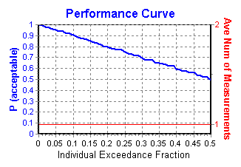
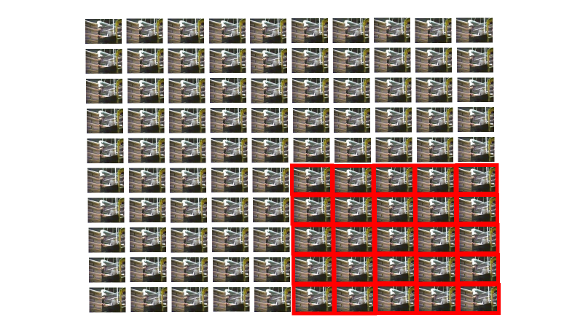
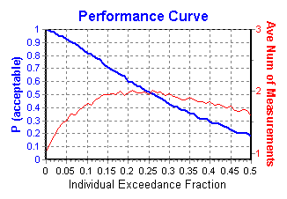
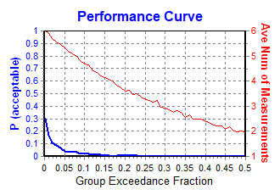
Comparison of EA Strategy Performance
Example of Unacceptable Operation:
Exposures Exceed OEL
25% of the Time.
Strategy Performance
OSHA Strategy
“Acceptable” 75% of the time
NIOSH Action Level Strategy
“Acceptable” 20% to 65% of the time, depending on GSD
AIHA Strategy
95% confident that 95%ile less than OEL
“Acceptable” <1% of the time
11

Slide 12
So what are we asking?
12

Slide 13

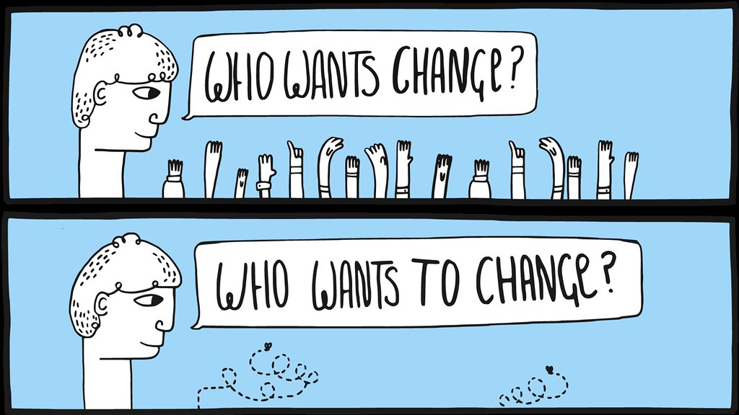
AIHA - ACGIH Initiative:
Improving Exposure
Judgement Accuracy
Improve Practice to Align
with Current Science
Drive a significant shift in the OEHS practice paradigm: from one where tools and activities to improve exposure judgment accuracy and interpretation are rarely or sporadically used, to one where their use is routine and expected.
AIHA.org/IEJ
This Photo licensed under CC BY
http://audiencestack.com/

Slide 14
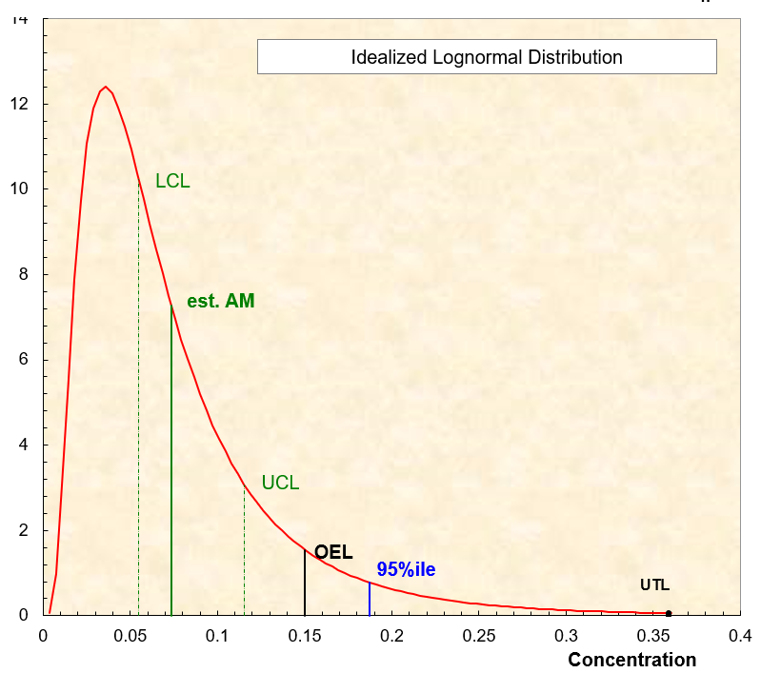
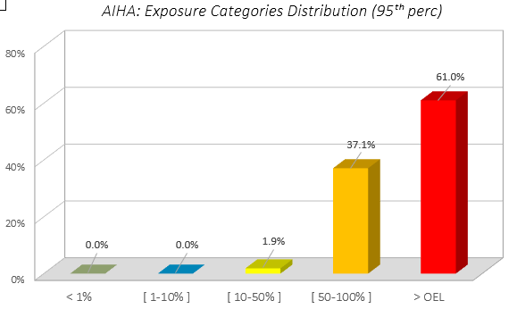
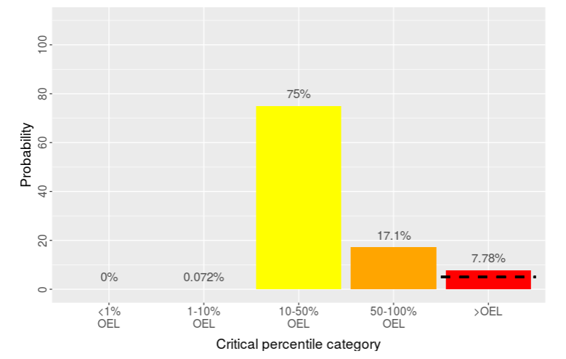
USE STATISTICAL TOOLS!
Traditional Statistics
Bayesian Statistics
IHDA-AIHA
IHSTAT-Bayes
Multi-Language
AIHA IHSTAT©
Expostats
Macro-Free

Slide 15
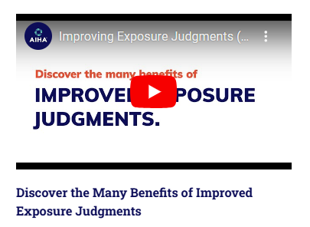
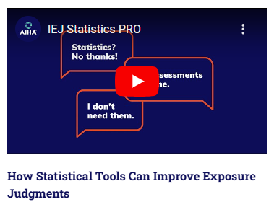
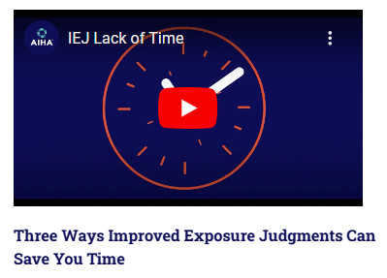
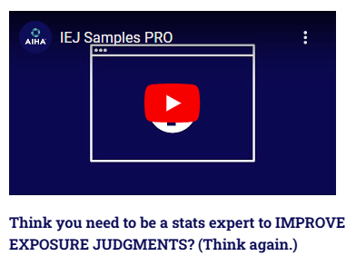
AIHA - ACGIH Initiative:
Education and Resources
AIHA.org/IEJ
15

Slide 16
Improving exposure decision accuracy:
Free CompleTE RESOURCE PACKAGE
Tools
Training
Assessment of Competency and Performance
IHSTAT-Bayes
Expostats
AIHA IHSTAT©
IHDA-AIHA
Free Webinar on Statistical Analysis Tools
9 Contact Hours
Access Resource Package HERE

Slide 17
Free Webinar on Statistical Analysis Tools
Participant Feedback: 49% Response Rate (537 / 1104)
Would you recommend this course?
“Statistics made simple – this should be a prerequisite for all industrial hygienists!”
Rate your overall satisfaction with this course and the contents
“With this course, the light bulb went off. I have never liked/used statistics until I took this course.”
“The course takes us (IHs) to the next level. It's where we should be at in our practice.”
“A great overview of IH data analysis- a must for anyone charged with the interpretation of sampling results!”
“One of the easiest-to-understand offerings on this subject; ideal for individuals with little background or natural aptitude for the concepts.”
“Great course. Every IH professional needs to take this course. This rubric should become part of the CIH exam.”

Slide 18
OUR challenge to you
Improve the Accuracy and Efficiency of Your Exposure Assessment Decisions
Commit to the FREE Exposure Decision Analysis (EDA) Registry!
Benefits Include:
Independent validation of your knowledge, skills and performance in making accurate exposure decisions based on monitoring data.
Recognition of your competency in rendering accurate decisions about worker exposure and exposure uncertainty.
Improve the overall quality of your management of workplace exposures.
Requirements (No Prerequisites)
Score ≥70% on first exam based on the knowledge needed to accurately interpret exposure monitoring data.
Score ≥70% on second exam based on the correct interpretation of supplied data sets.
Affirm a commitment to continuous improvement.
Registration is valid for 5 years
Free Assessment of the Knowledge, Skills and Performance Needed to Accurately Interpret Exposure Monitoring Data

Slide 19

Questions and Answers

Slide 20
Additional Slides

Slide 21
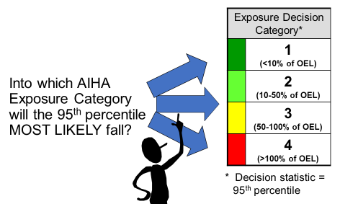
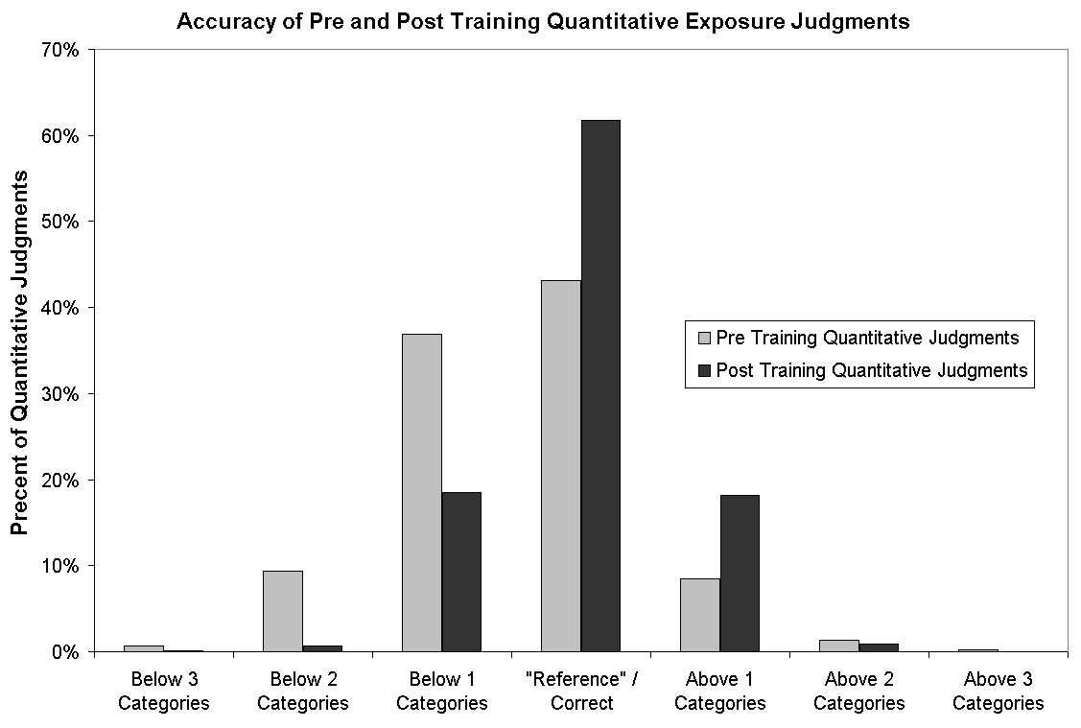
The Science: we are often wrong
Poor Accuracy & Underestimation Bias when we do not use tools and activities to improve exposure judgment accuracy!
With Monitoring Data
Research Studies Asked:
Video Tasks*
21
21
*Logan et.al. Ann of Occ Hyg, Vol. 53, No. 4, 2009

Slide 22
Decision Statistic:
Defines Objective for Acceptable Exposure
(i.e., No Further Intervention Needed)
Relative to Appropriate OEL
Defined BEFORE Conducting Exposure Risk Assessment

Slide 23
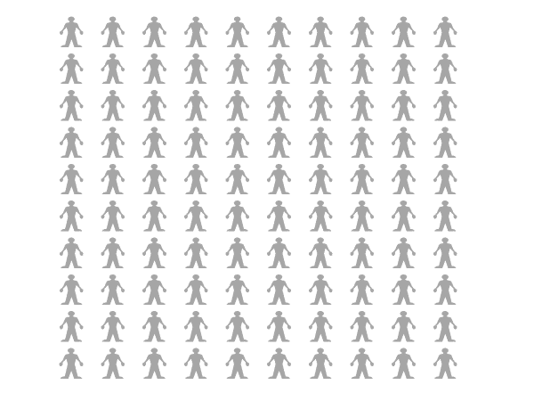
Decision Statistic – 1st Framing Question
What is an “Acceptable” exposure?
Question - An employee performs a job 100 days per year. If you collected personal samples everyday, how many days is it acceptable for exposures to exceed the Occupational Exposure Limit (OEL) without a respirator?
0 Days
1 Days
5 Days
10 Days
25 Days
50 Days

Slide 24
Decision Statistic:
1st Framing Question
An employee performs a job 100 days per year. If you collected personal samples on the employee all 100 days, how many days is it acceptable for exposures to exceed the Occupational Exposure Limit (OEL) without a respirator?
  1) 0 days?
  2) 1 days?
  3) 5 days?
  4) 10 days?
  5) 25 days?
  6) 50 days?
95%ile
5/100 (5%) above
95/100 (95%) below
Answers emphasize the desire for very few days above the OEL
Professional consensus developing around targeting for no more than 5 days out of 100 above the OEL (i.e. 95th Percentile)
Notes:
How many days do we want the 95%tile of the data to be below the OEL?

Slide 25
Decision Statistic – 2nd Framing Question
How sure do you want to be in your judgment?
100% Sure
99% Sure
95% Sure
90 % Sure
70% Sure
50% Sure
?
?

Slide 26
Decision Statistic:
2nd Framing Question
?
How sure do you want to be in your judgment?
?
1) 100% Sure?
2) 99%?
3) 95%?
4) 90%?
5) 70%?
6) 50%?
Answers express the desire for high confidence that employees are protected.
Implementing the AIHA Strategy with its emphasis on driving follow-up actions and continuous improvement enables a program to strive for high confidence.
Common to strive for 95% confidence.
Notes:
How sure (i.e., confident) do you want to be that the employees are exposed to below the OEL?
How confident do you want to be that the 95%tile is below the OEL?

Slide 27
PGP Decision Statistic:
Good Practice: At least 70% confident that the true 95th percentile exposure is less than the OEL
Enhanced Practice: Strive to be at least 95% confident that the true 95th percentile exposure is less than the OEL
OEL
Are we getting this performance from current exposure assessment and management programs?
95%ile
95%ile UCL_{70%}
95%ile UCL_{95%}

Slide 28
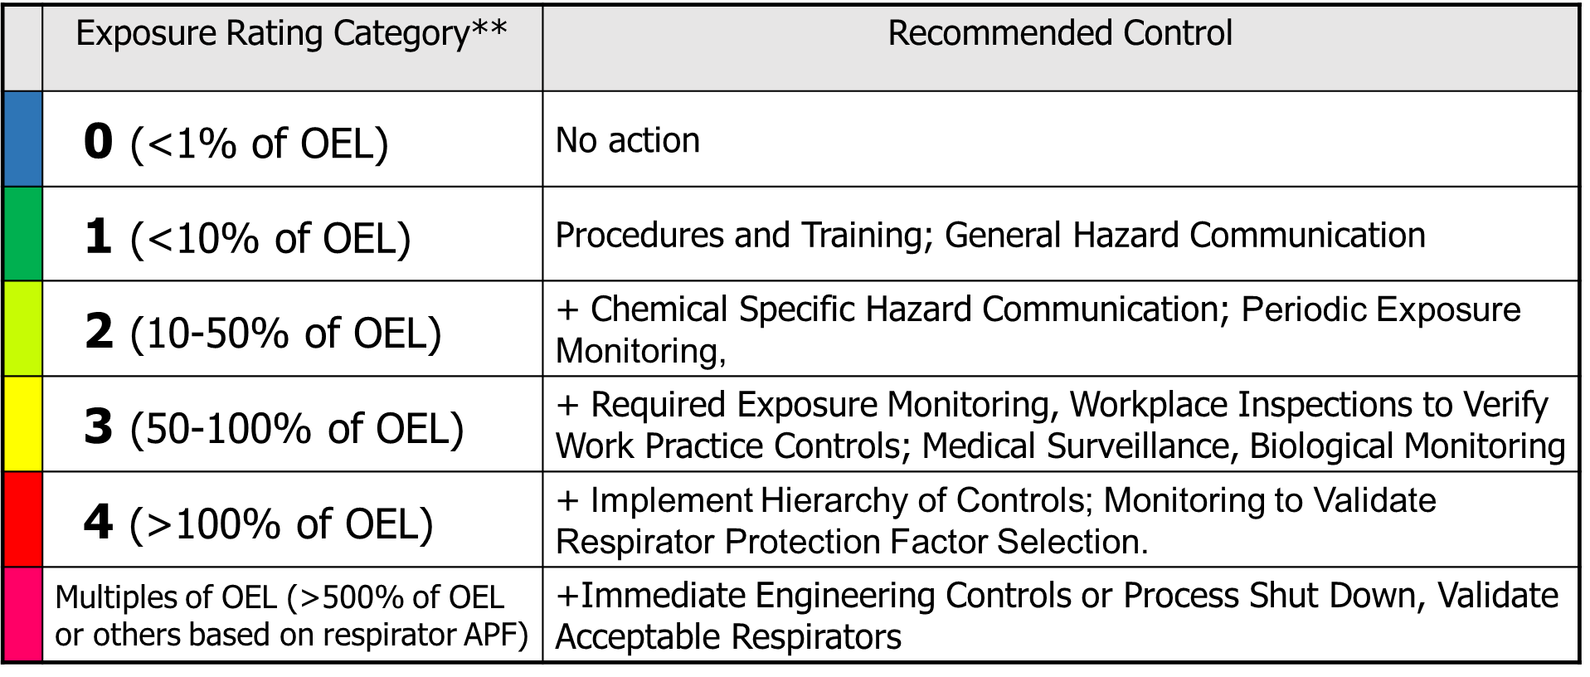
Into which AIHA Exposure Category will the 95th percentile MOST LIKELY fall?
OEL = 100 ppm
Sample Results (ppm)
18 15 5 8 12
?
* Decision statistic = 95th percentile

Slide 29
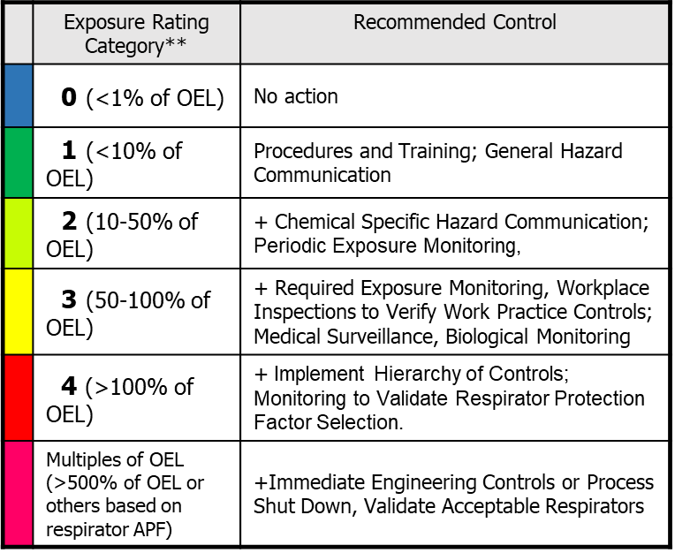
Into which AIHA Exposure Category will the 95th percentile MOST LIKELY fall?
OEL = 100 ppm
“Best Guess” Population (SEG) Exposure Profile
Sample Results (ppm)
18 15 5 8 12
Inferential Statistics
Exposure
Category
GM = 10.5 ppm
GSD = 1.67
95%ile = 24.5 ppm
95%ile UCL_{95,95} (UTL) = 91.6 ppm
Follow-Up Actions

Slide 30
Into which AIHA Exposure Category will the 95th percentile MOST LIKELY fall?
Why we are doing this!
OEL = 100 ppm
“Best Guess” Population (SEG) Exposure Profile
Sample Results (ppm)
18 15 5 8 12
Inferential Statistics
Exposure
Category
GM = 10.5 ppm
GSD = 1.67
95%ile = 24.5 ppm
95%ile UCL_{95,95} (UTL) = 91.6 ppm
Follow-Up Actions

Slide 31
Into which AIHA Exposure Category will the 95th percentile MOST LIKELY fall?
Example 1
OEL = 100 ppm
Sample Results (ppm)
18 15 5 8 12
?
* Decision statistic = 95th percentile

Slide 32
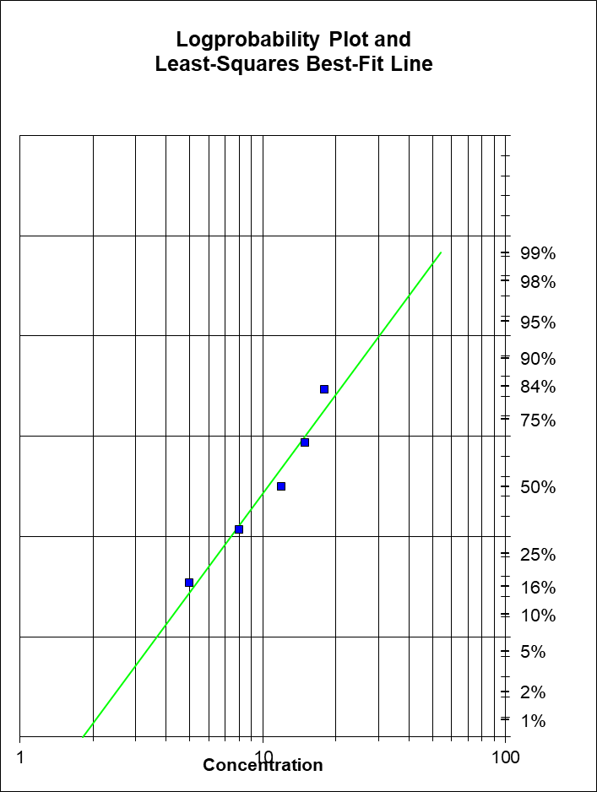
OEL = 100 ppm
GM = 10.5 ppm
GSD = 1.67
95%ile = 24.5 ppm
95%ile UCL_{95,95} = 91.6 ppm
Sample Results (ppm)
18 15 5 8 12
Exposure Rating Category* | 0 (<1% of OEL) | 1 (<10% of OEL) | 2 (10-50% of OEL) | 3 (50-100% of OEL) | 4 (>100% of OEL) | Multiples of OEL (>500% of OEL or others based on respirator APF)
Recommended Control | No action | Procedures and Training; General Hazard Communication | + Chemical Specific Hazard Communication; Periodic Exposure Monitoring, | + Required Exposure Monitoring, Workplace Inspections to Verify Work Practice Controls; Medical Surveillance, Biological Monitoring | + Implement Hierarchy of Controls; Monitoring to Validate Respirator Protection Factor Selection. | +Immediate Engineering Controls or Process Shut Down, Validate Acceptable Respirators

Slide 33
OEL = 100 ppm
GM = 10.5 ppm
GSD = 1.67
95%ile = 24.5 ppm
95%ile UCL_{95,95} = 91.6 ppm
95%ile Most Likely in Category 2
(Medium Certainty)
Sample Results (ppm)
18 15 5 8 12
Exposure Rating Category* | 0 (<1% of OEL) | 1 (<10% of OEL) | 2 (10-50% of OEL) | 3 (50-100% of OEL) | 4 (>100% of OEL) | Multiples of OEL (>500% of OEL or others based on respirator APF)
Recommended Control | No action | Procedures and Training; General Hazard Communication | + Chemical Specific Hazard Communication; Periodic Exposure Monitoring, | + Required Exposure Monitoring, Workplace Inspections to Verify Work Practice Controls; Medical Surveillance, Biological Monitoring | + Implement Hierarchy of Controls; Monitoring to Validate Respirator Protection Factor Selection. | +Immediate Engineering Controls or Process Shut Down, Validate Acceptable Respirators

Slide 34
OEL = 100 ppm
GM = 10.5 ppm
GSD = 1.67
95%ile = 24.5 ppm
95%ile UCL_{95,95} = 91.6 ppm
95%ile Most Likely in Category 2
(Medium Certainty)
Sample Results (ppm)
18 15 5 8 12
More Than 95% Confident That True 95%ile Exposure <OEL
Exposure Rating Category* | 0 (<1% of OEL) | 1 (<10% of OEL) | 2 (10-50% of OEL) | 3 (50-100% of OEL) | 4 (>100% of OEL) | Multiples of OEL (>500% of OEL or others based on respirator APF)
Recommended Control | No action | Procedures and Training; General Hazard Communication | + Chemical Specific Hazard Communication; Periodic Exposure Monitoring, | + Required Exposure Monitoring, Workplace Inspections to Verify Work Practice Controls; Medical Surveillance, Biological Monitoring | + Implement Hierarchy of Controls; Monitoring to Validate Respirator Protection Factor Selection. | +Immediate Engineering Controls or Process Shut Down, Validate Acceptable Respirators
Follow-Up Actions:
Procedures and Training; General Haz. Com.
+ Chemical Specific Haz. Com.; Periodic Exposure Monitoring,

