Slide 1
AIHA Heat stress app
Introduction & Overview
Version 2
Summer 2025

Slide 2

Impact of heat
Workers exposed to extreme heat, especially those engaged in strenuous physical activities, may be at risk for heat stress.
Occupational exposure to heat can result in injuries, disease, reduced productivity, and death.
Heat Stress = external conditions resulting in
Heat Strain = impact on individual
An individual’s underlying health condition(s) can exacerbate the body's response to heat stress.

Slide 3
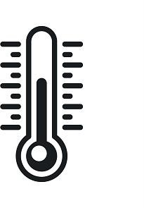
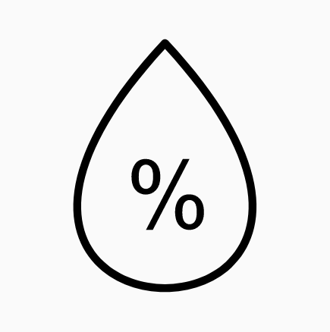


WET BULB GLOBE TEMPERATURE (WBGT) INDEX
Weighted average of dry bulb, wet bulb and globe temperatures
Incorporates 4 environmental heat determinants:
Air temperature
Relative humidity
Air movement
Radiant heat
aiha.org | 4

Slide 4
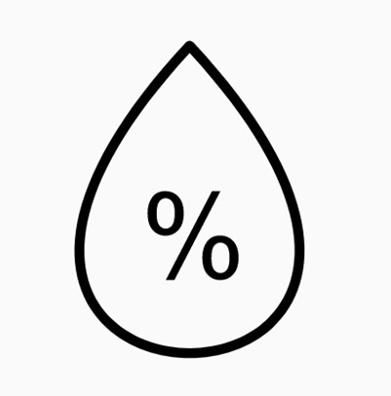


WBGT INDEX
Preferred environmental heat metric for Heat Related Illness (HRI) prevention in workplaces
‒ Measuring WBGT at the worksite provides the most accurate information about the workers’ heat exposure. (CDC 2018)
‒ Advocated as part of occupational heat stress prevention programs (ACGIH 2019, NIOSH 2016)
aiha.org | 5

Slide 5
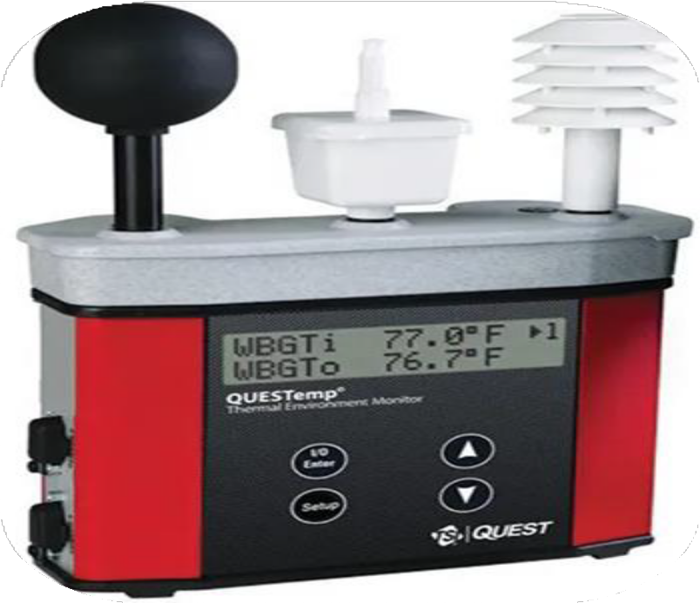
WET BULB GLOBE TEMPERATURE (WBGT) INDEX
4 components: Air temperature Relative humidity Wind speed
Radiant heat
Types of Thermometers:
Dry bulb (T_{db})
Wet bulb (T_{wb}) Globe (T_{g})
Outdoor WBGT = 0.7T_{wb} + 0.2T_{g} + 0.1T_{db}
aiha.org | 6

Slide 6
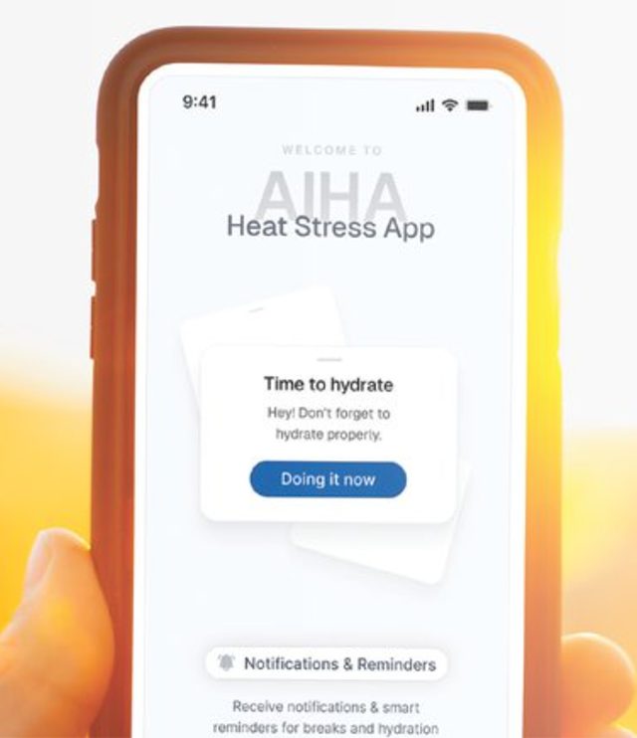
AIHA’s heat stress app
Proposed by the AIHA Thermal Stress Working Group (open to anyone)
Partnership between East Carolina University and Dualboot Partners
A reference tool – it carries NO regulatory authority; references federal guidelines published by US OSHA and CDC/NIOSH + practical cooling strategies
FREE app compatible with both iOS and Android platforms
NO pop-up ads
Available in English, Spanish, Portuguese, and French
Can be used globally
NO interface with physiological monitors; NO personal data are collected
Not a replacement for the current OSHA/NIOSH Heat Safety Tool
Designed for both Employers and Employees
Includes quick reads on related topics (written in plain English for non-technical users)
Calculates Adjusted WBGT, corresponding to heat stress risk level with federal regulatory and practical health recommendations
NOW AVAILABLE: VER 2 for ALL workers (outdoor + indoor)

Slide 7
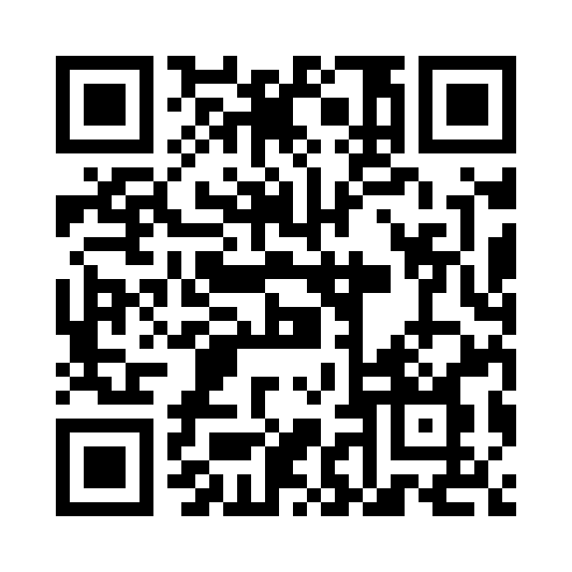

Access the app
Apple and Android Links
available on our site

Slide 8
APP functionalities from Version 1
  User inputs:
    Location (one or more) -> pulls current weather data from your local National Weather Service
    Workload intensity
    Type of clothing
    Cloud cover (for outdoor use only)
  Heat alerts (based on current location risk, assuming notifications are turned on)
  Enhancements since the initial launch
  Improved Location Search: Finding locations is now easier with more search results
  Customized Locations: Customize the configuration (user inputs) by location
  Clearer Location Names: Current location displays the city or a more specific name for better clarity
  Enhanced Forecast View: First hour of today’s forecast now shows "Now" to keep you updated in real-time
  Manual Location Sorting & Renaming: Sort and rename your saved locations for a more personalized experience (good for when you have multiple worksites in one geographic area)

Slide 9
What’s new in version 2
Indoor Heat Monitoring – Manually input temperature, humidity, and wind velocity for indoor environments OR select differential between outdoor & indoor conditions
Enhanced Heat Stress Calculation – Algorithm now accounts for nearby non-solar radiant heat sources (such as ovens, boilers, furnaces)
Save Your Defaults – Set and reuse your preferred configuration when adding new locations
Forecasting – Anticipate future WBGT, heat stress level with associated health recommendations, so you can plan ahead
Refreshed User Interface – Multiple improvements for a smoother and more intuitive experience
Notifications – Automatically sends heat stress alerts during work hours entered in the schedule module (triggered when WBGT reaches moderate, high, extreme); app checks conditions hourly; note that alerts are NOT customizable
Offline Mode – Notification when you are no longer connected to WiFi or cell service
Monitoring View – Under Settings, toggle ON to display a panoramic view of all types of workloads at a location (this may be particularly valuable to a supervisor managing crews working at different exertion levels at a site).

Slide 10
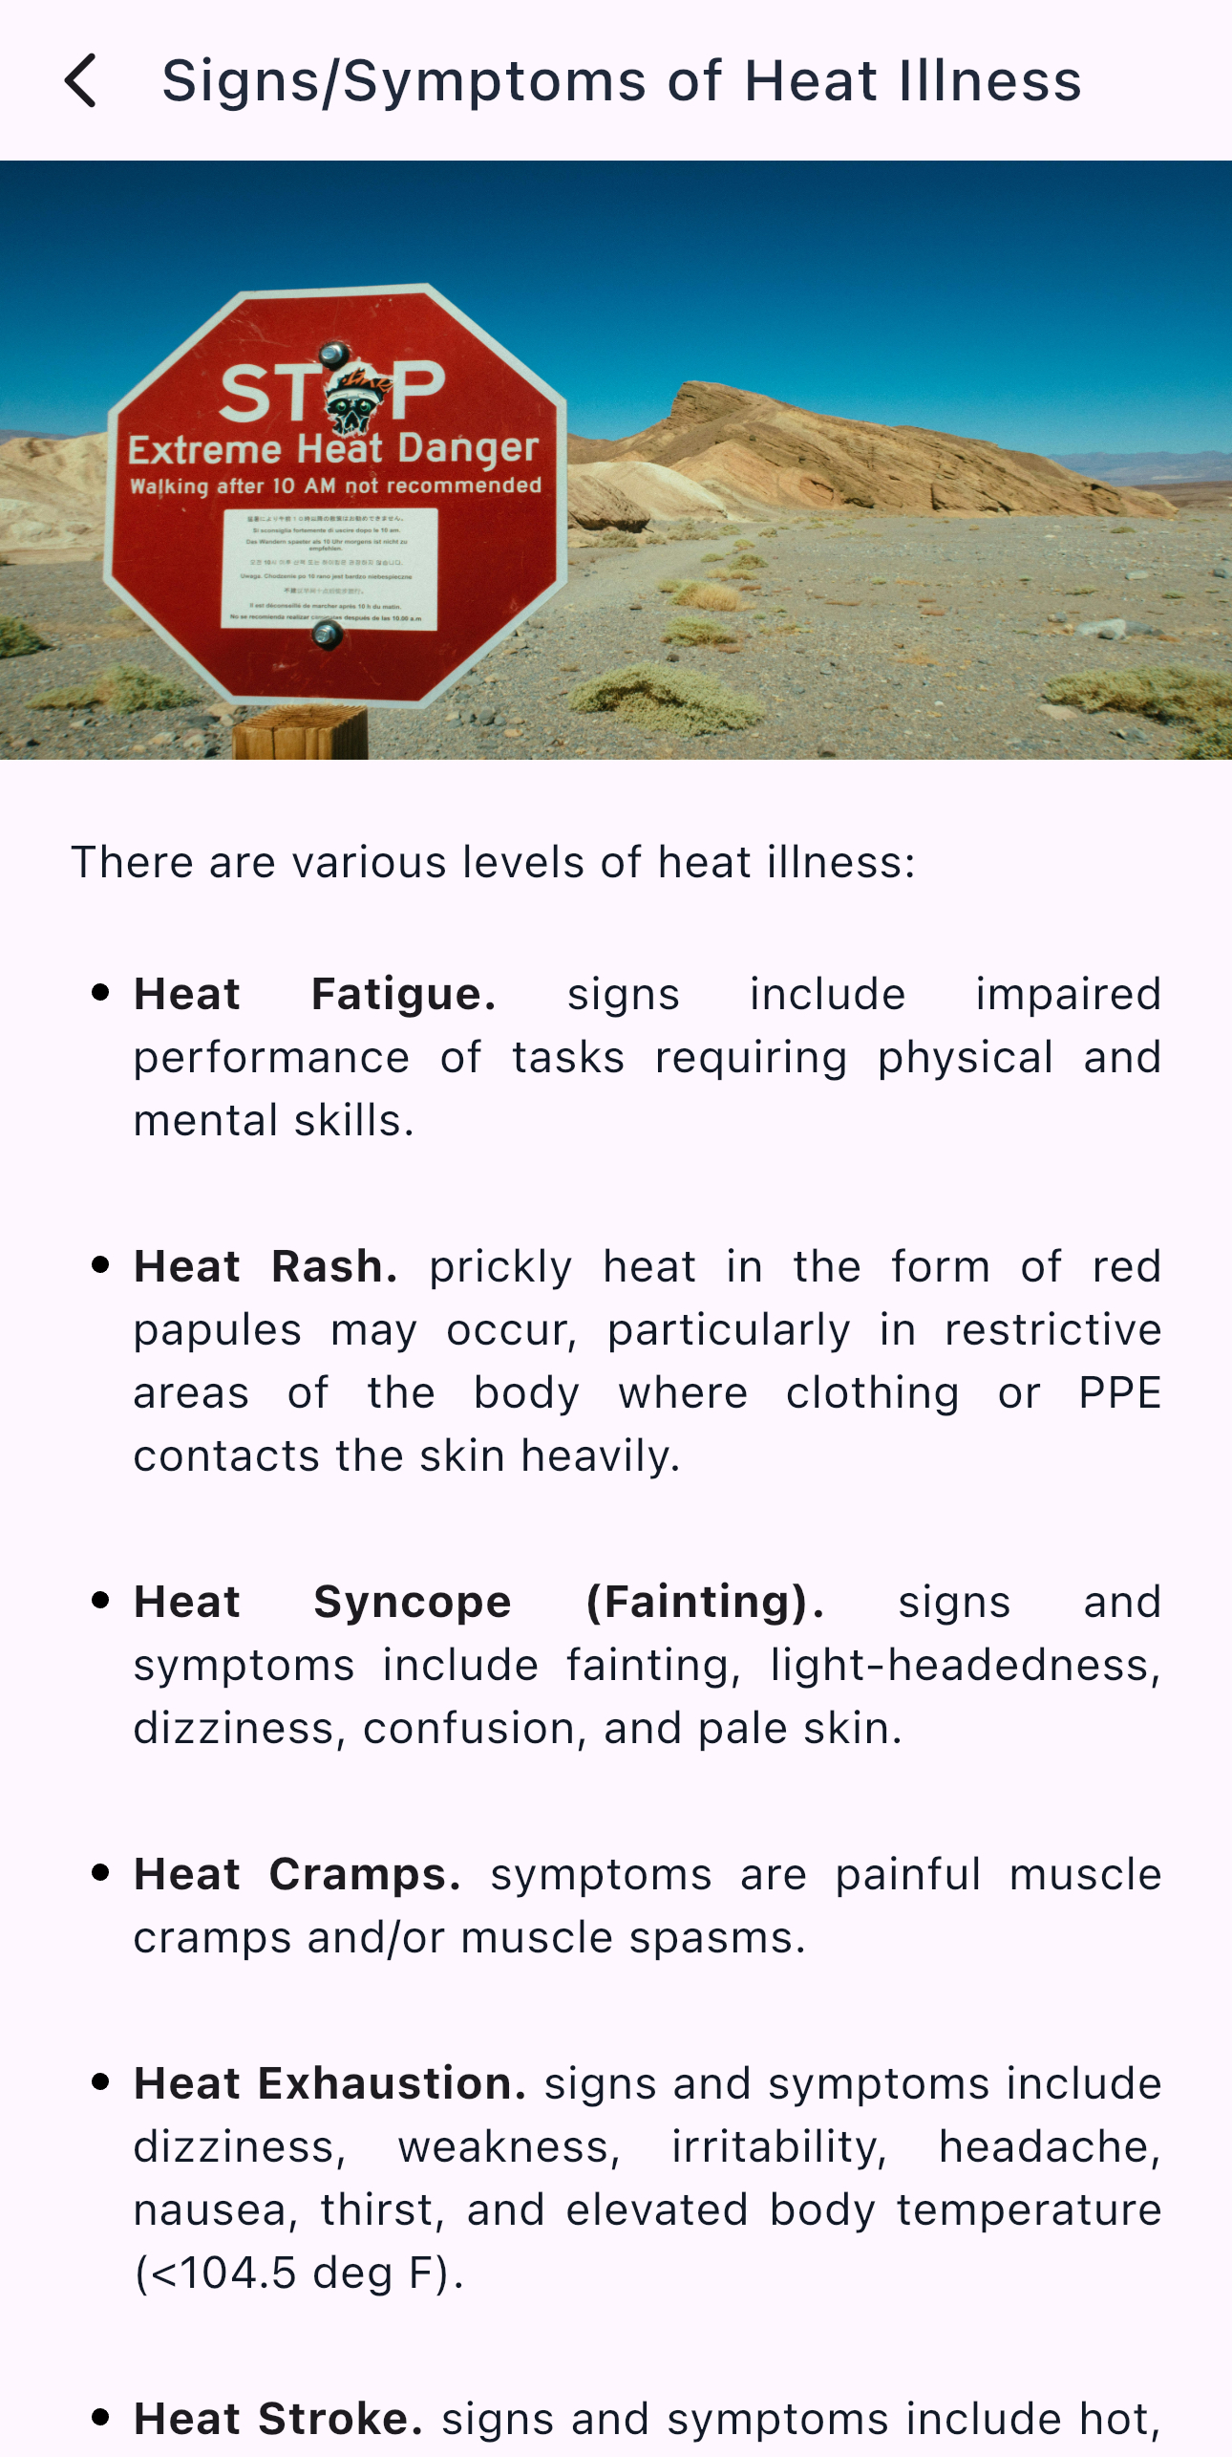
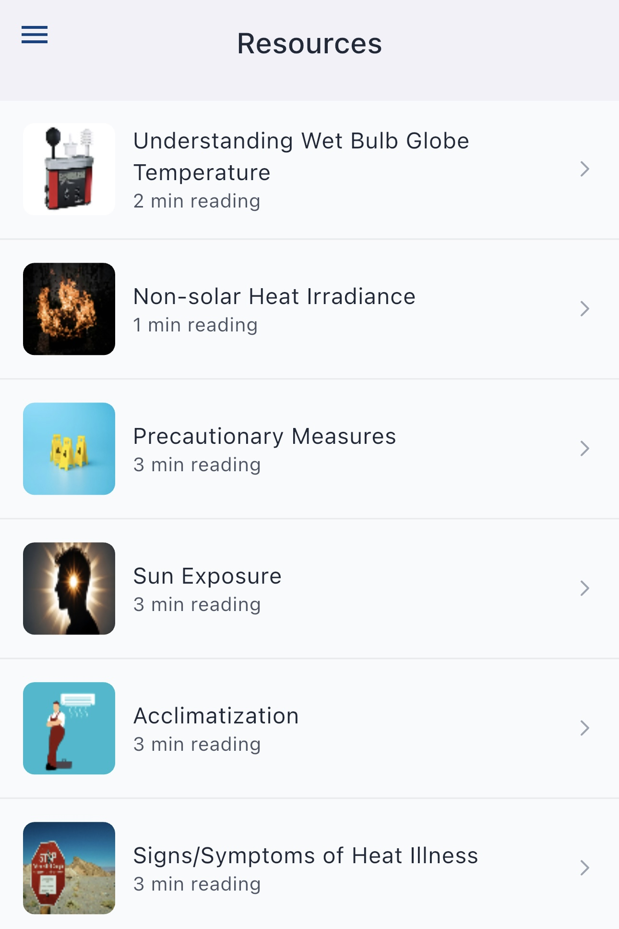
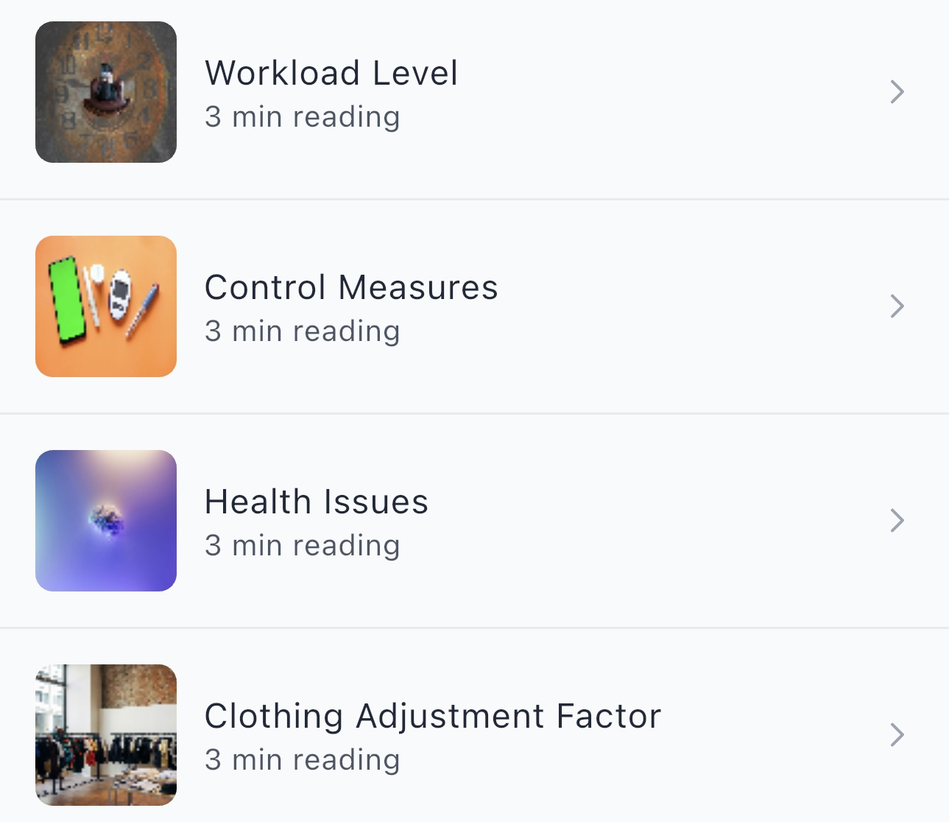
quick read topics

Slide 11

Our Vision: A world where all workers and their communities are healthy and safe​.
Questions about the app?
Lawrence Sloan, MBA, CAE, FASAE
Email: lsloan@aiha.org
Office: +1-703-846-0760 (Eastern Time USA)

